Slide 1
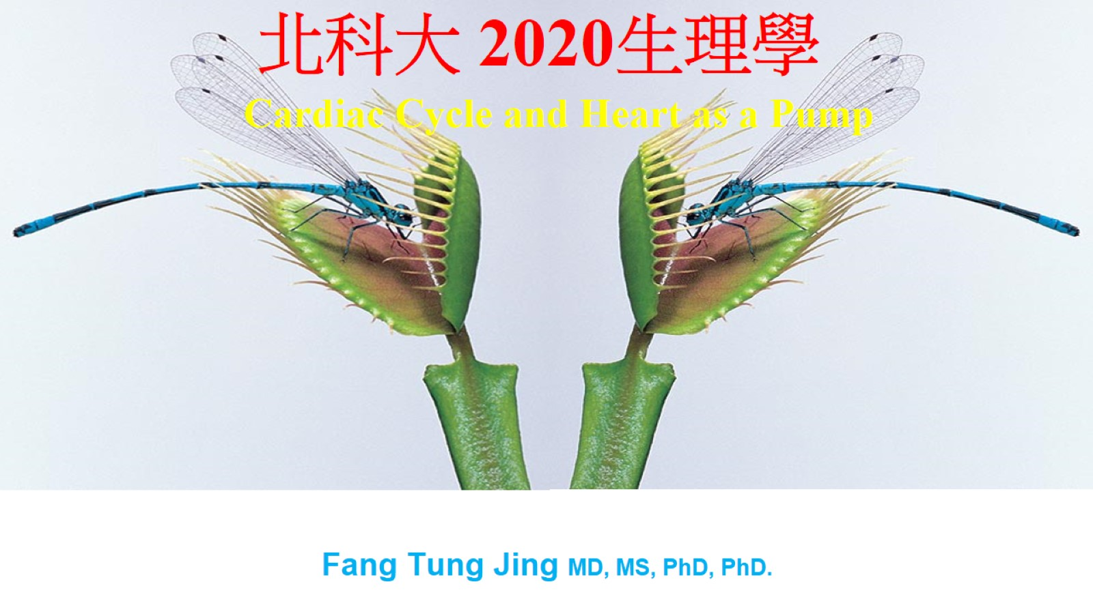

Slide 2
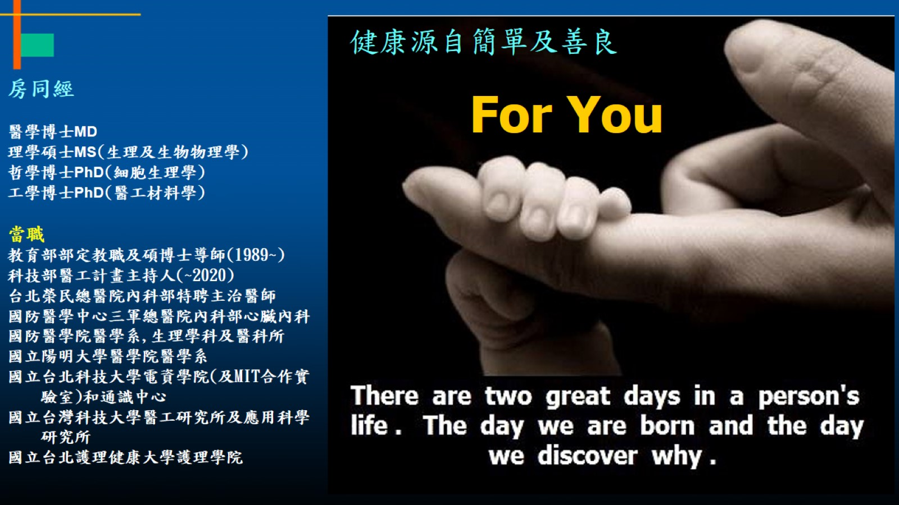
For You

Slide 3


Slide 4
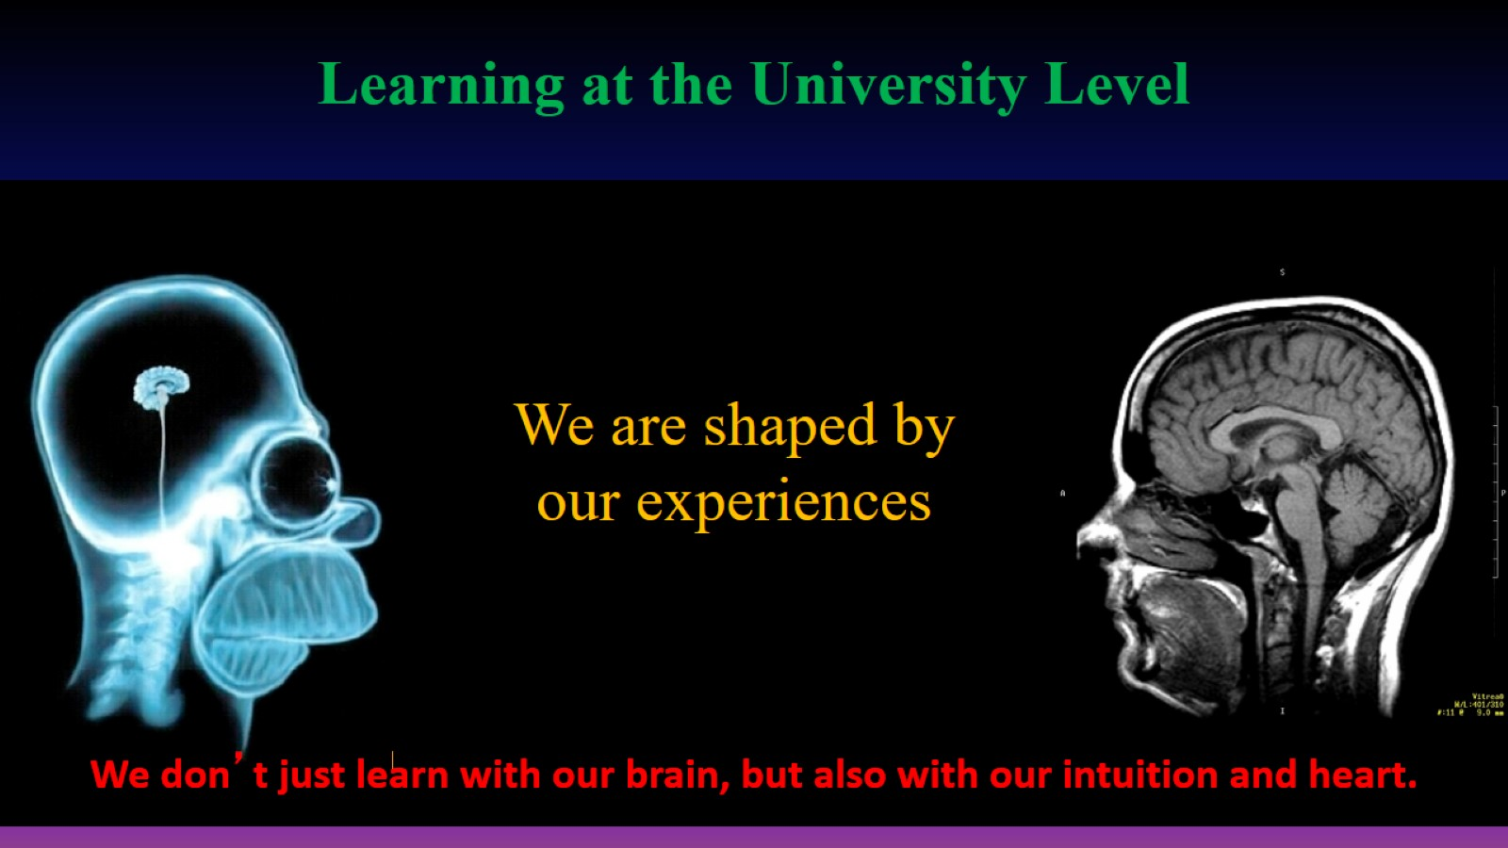
Learning at the University Level

Slide 5


Slide 6


Slide 7
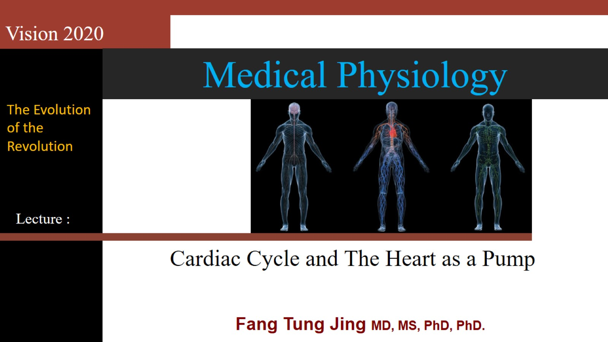
Lecture :

Slide 8
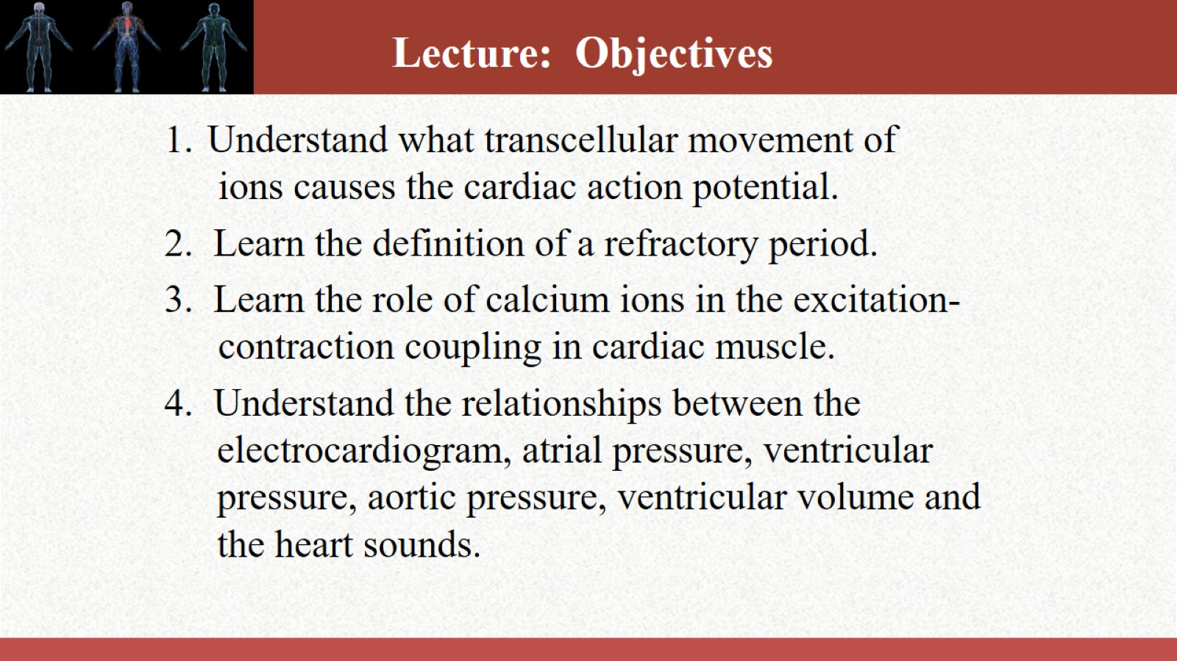
Lecture: Objectives

Slide 9
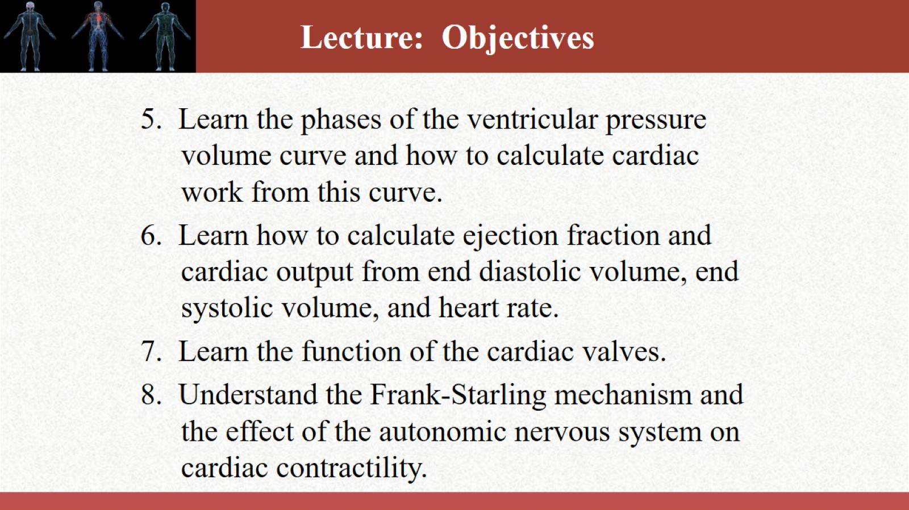
Lecture: Objectives

Slide 10
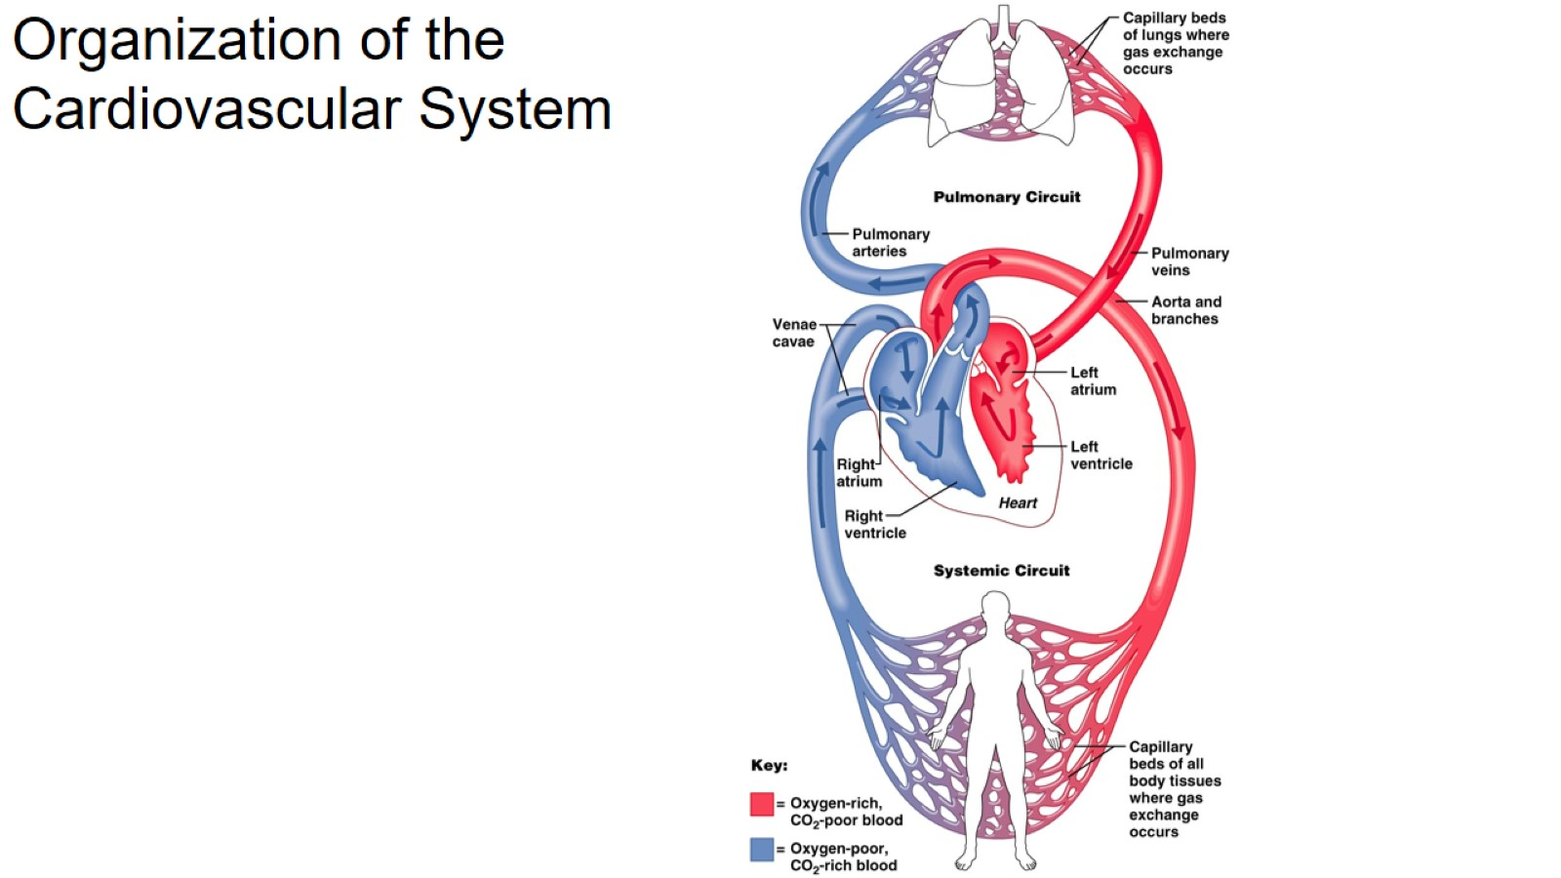
Organization of the Cardiovascular System

Slide 11
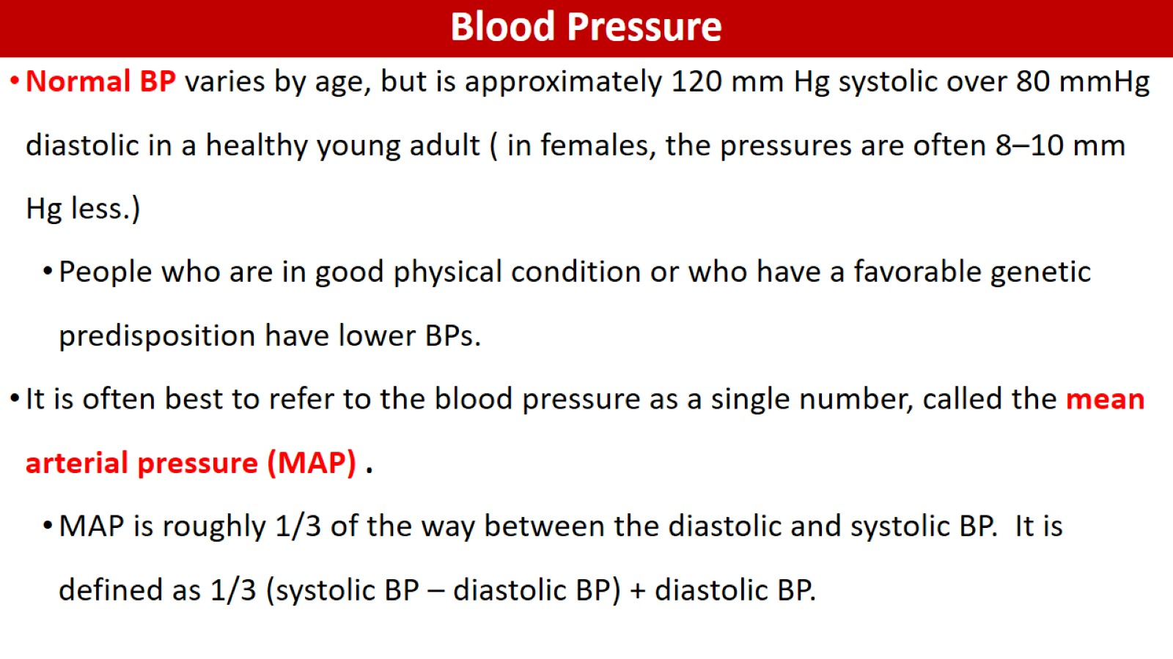
Blood Pressure

Slide 12
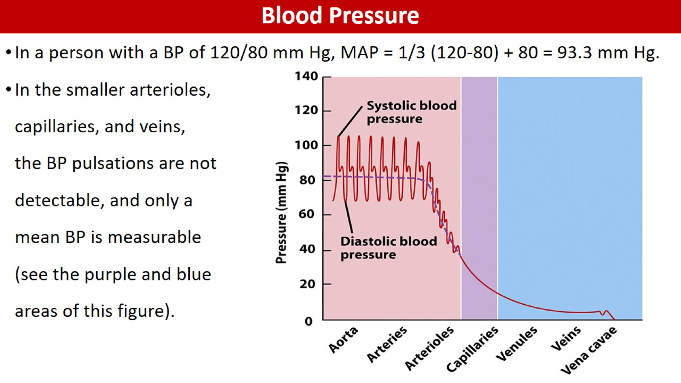

Slide 13
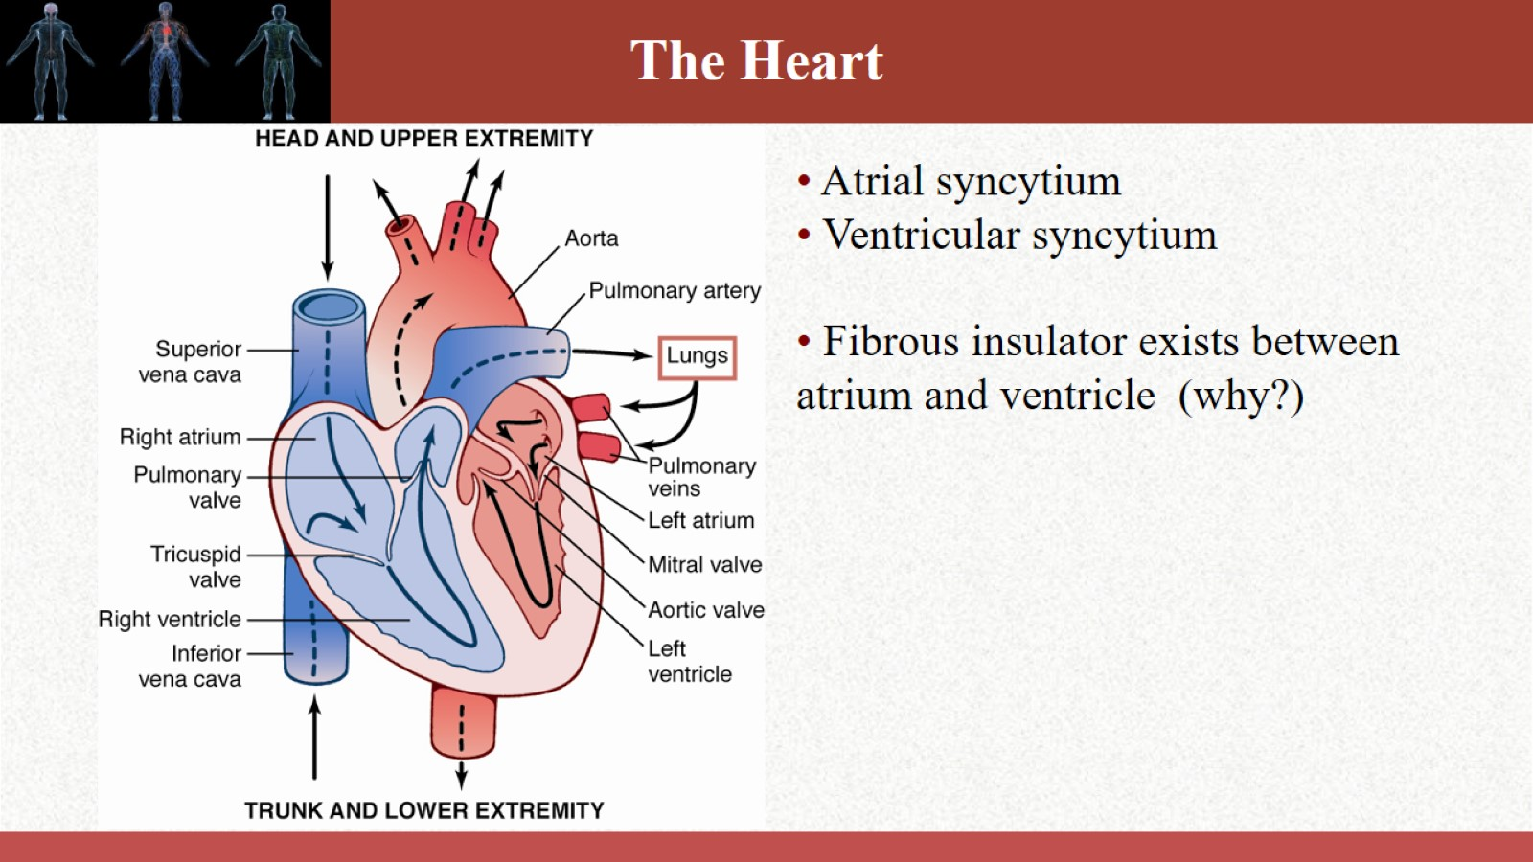
The Heart

Slide 14
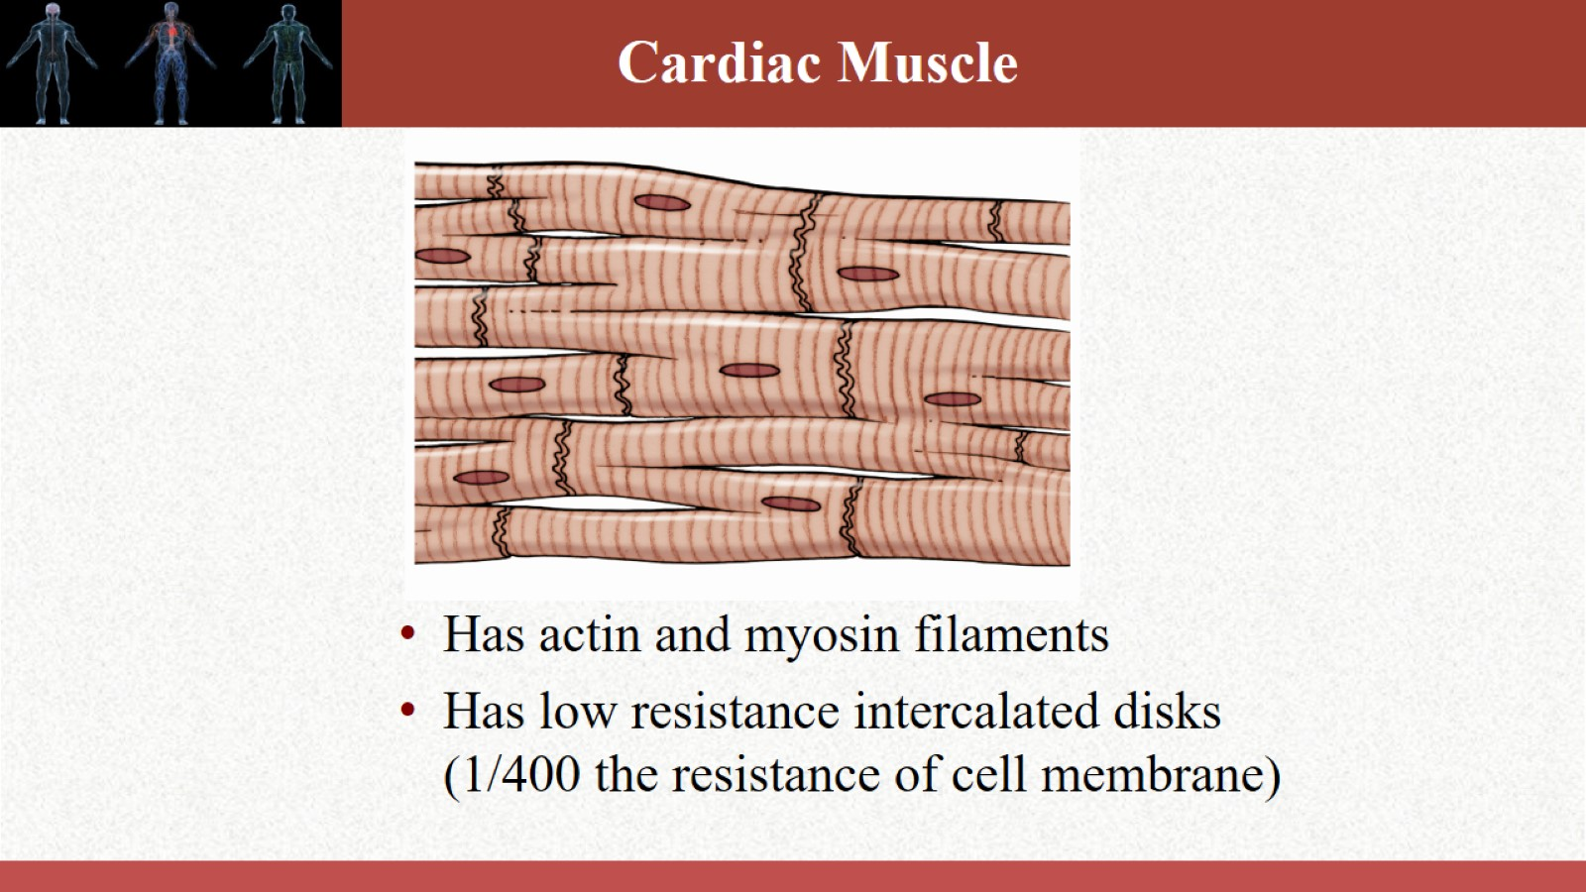
Cardiac Muscle

Slide 15
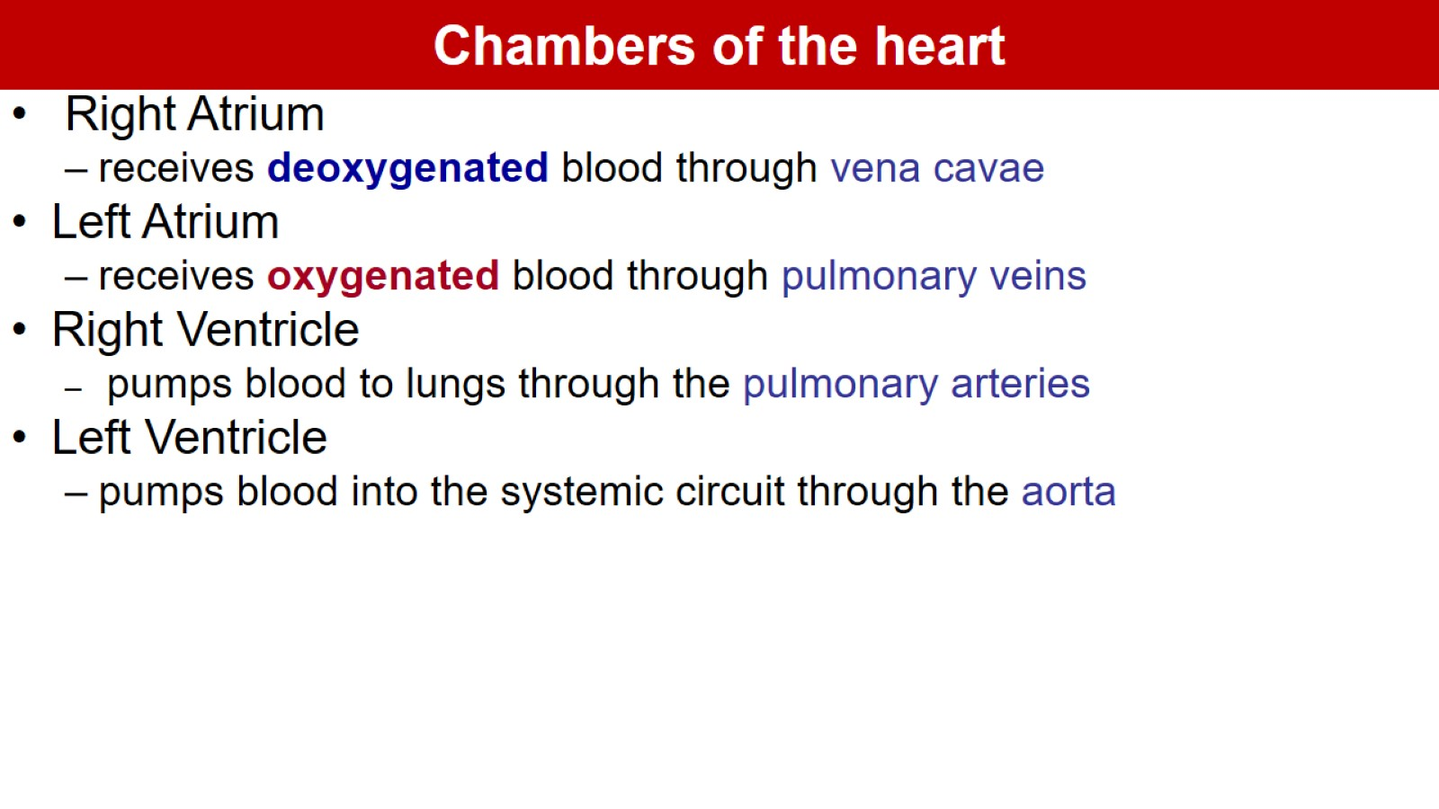
Chambers of the heart

Slide 16
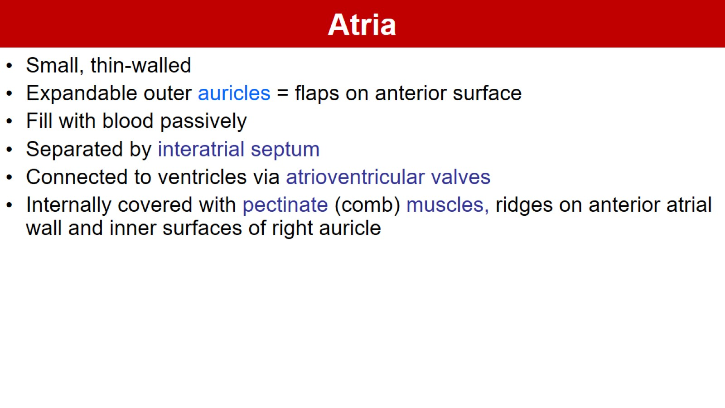
Atria

Slide 17
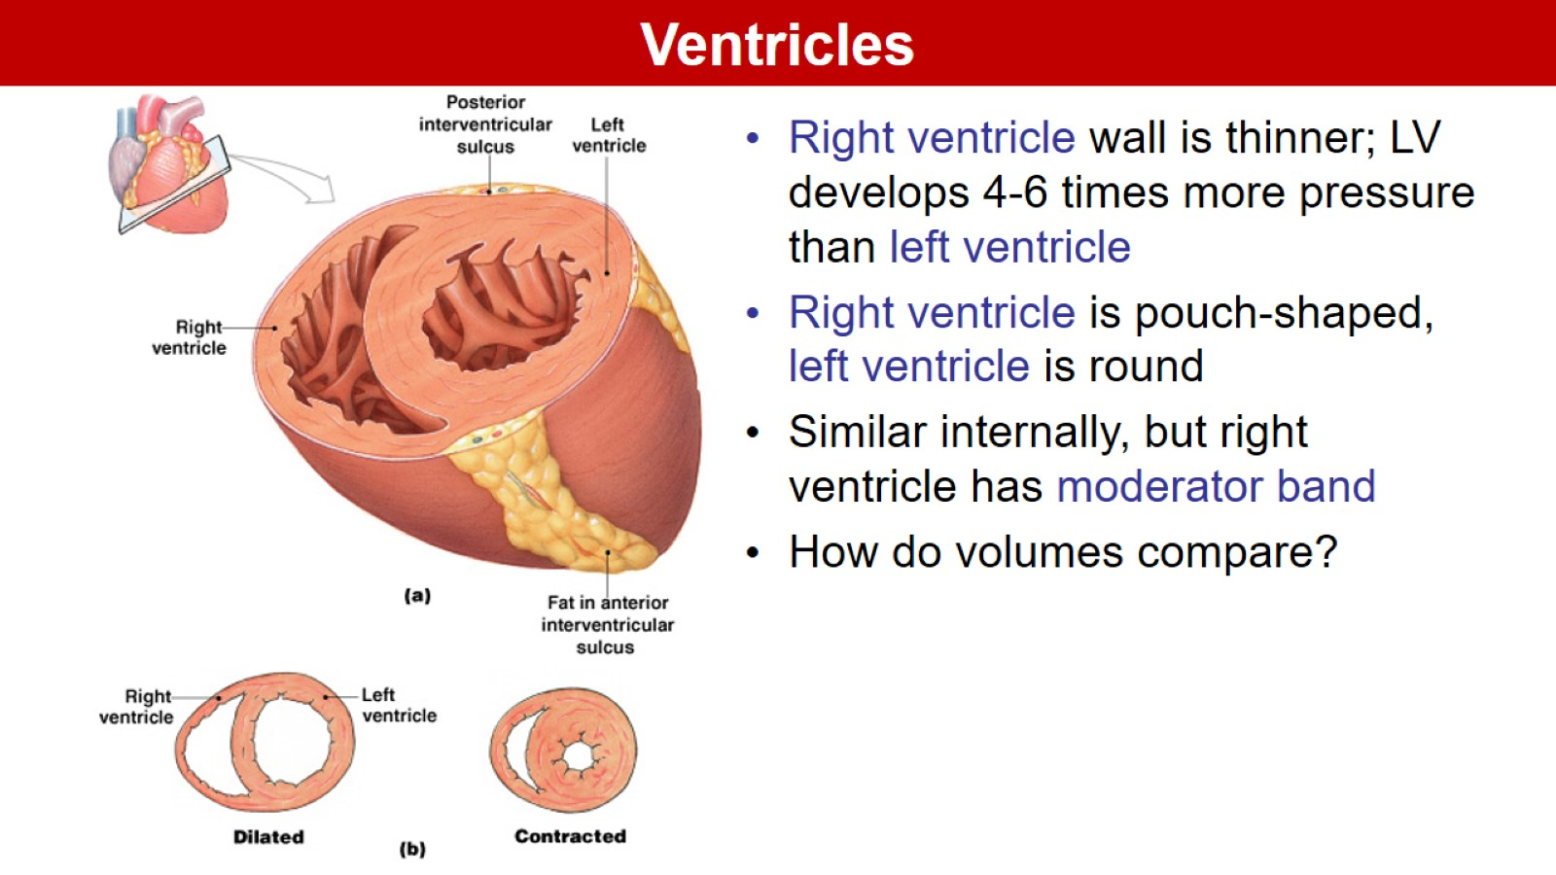
Ventricles

Slide 18
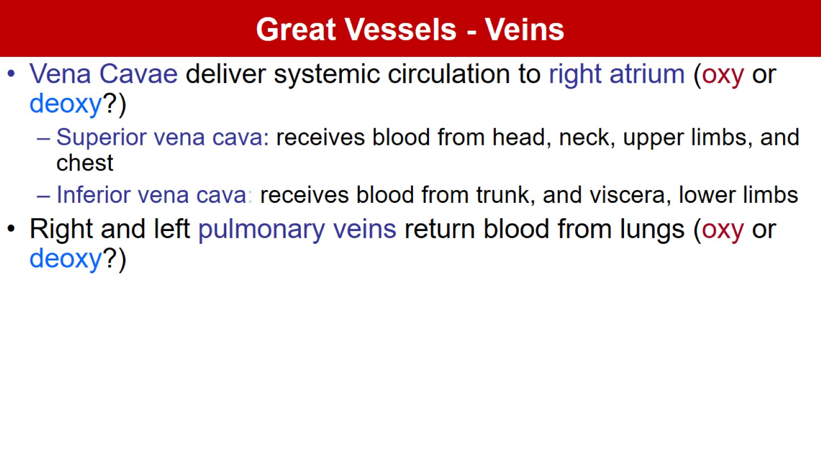
Great Vessels - Veins

Slide 19
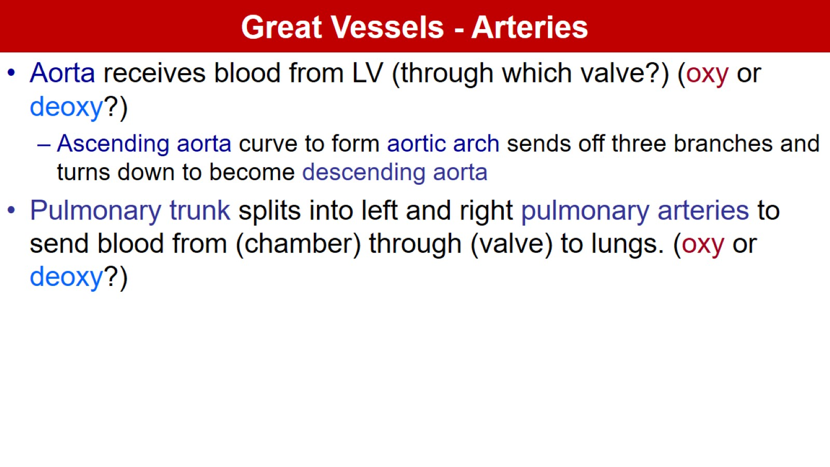
Great Vessels - Arteries

Slide 20
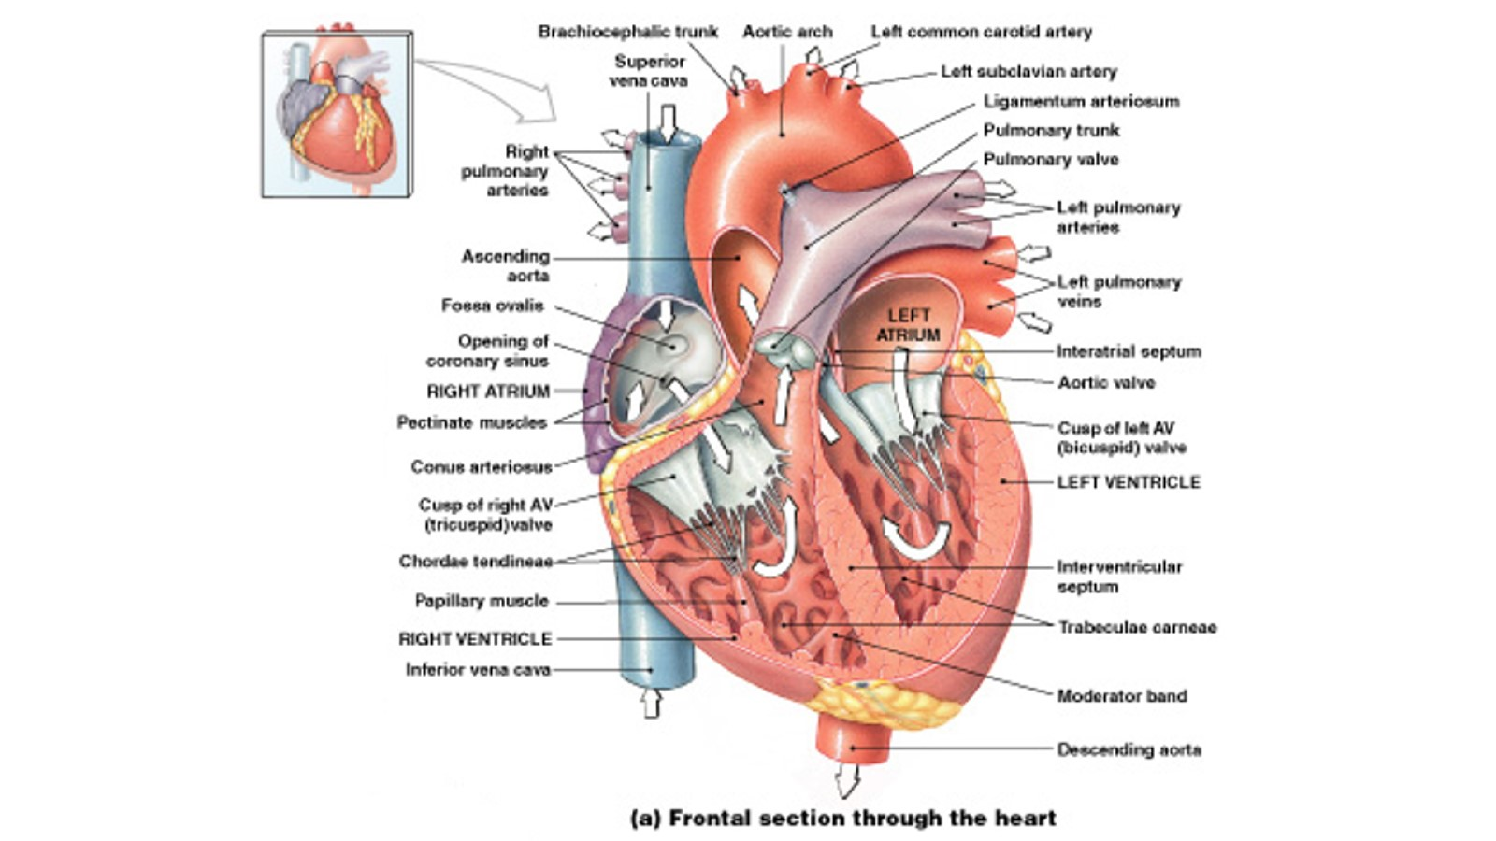

Slide 21
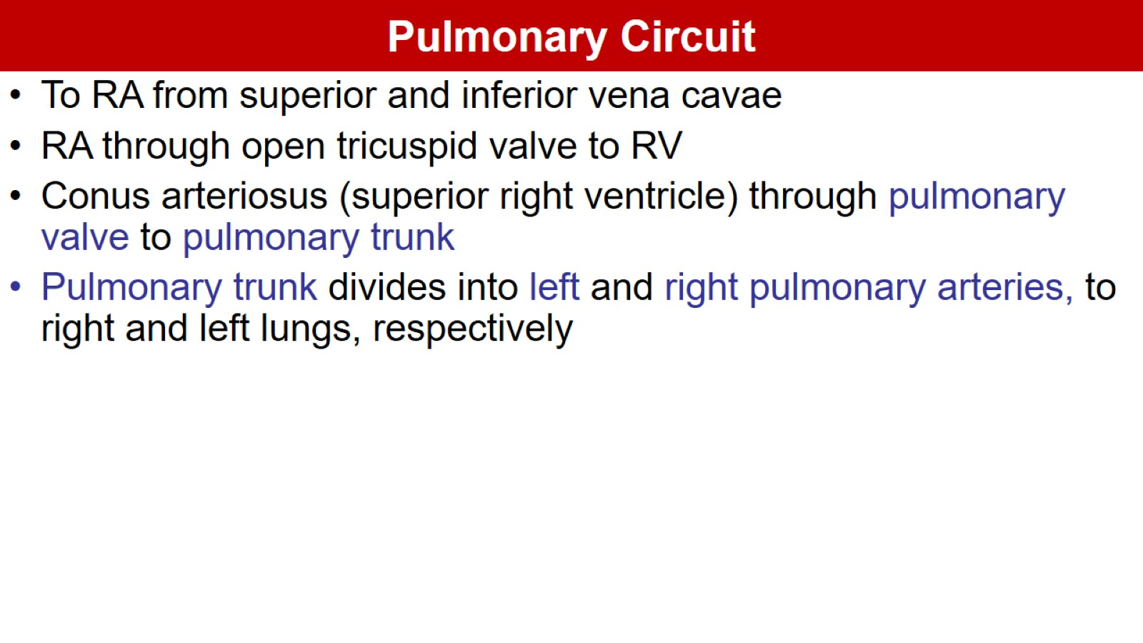
Pulmonary Circuit

Slide 22
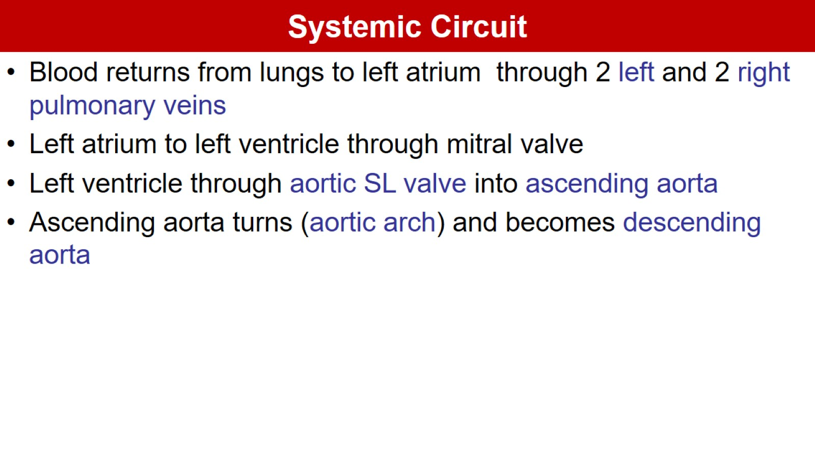
Systemic Circuit

Slide 23
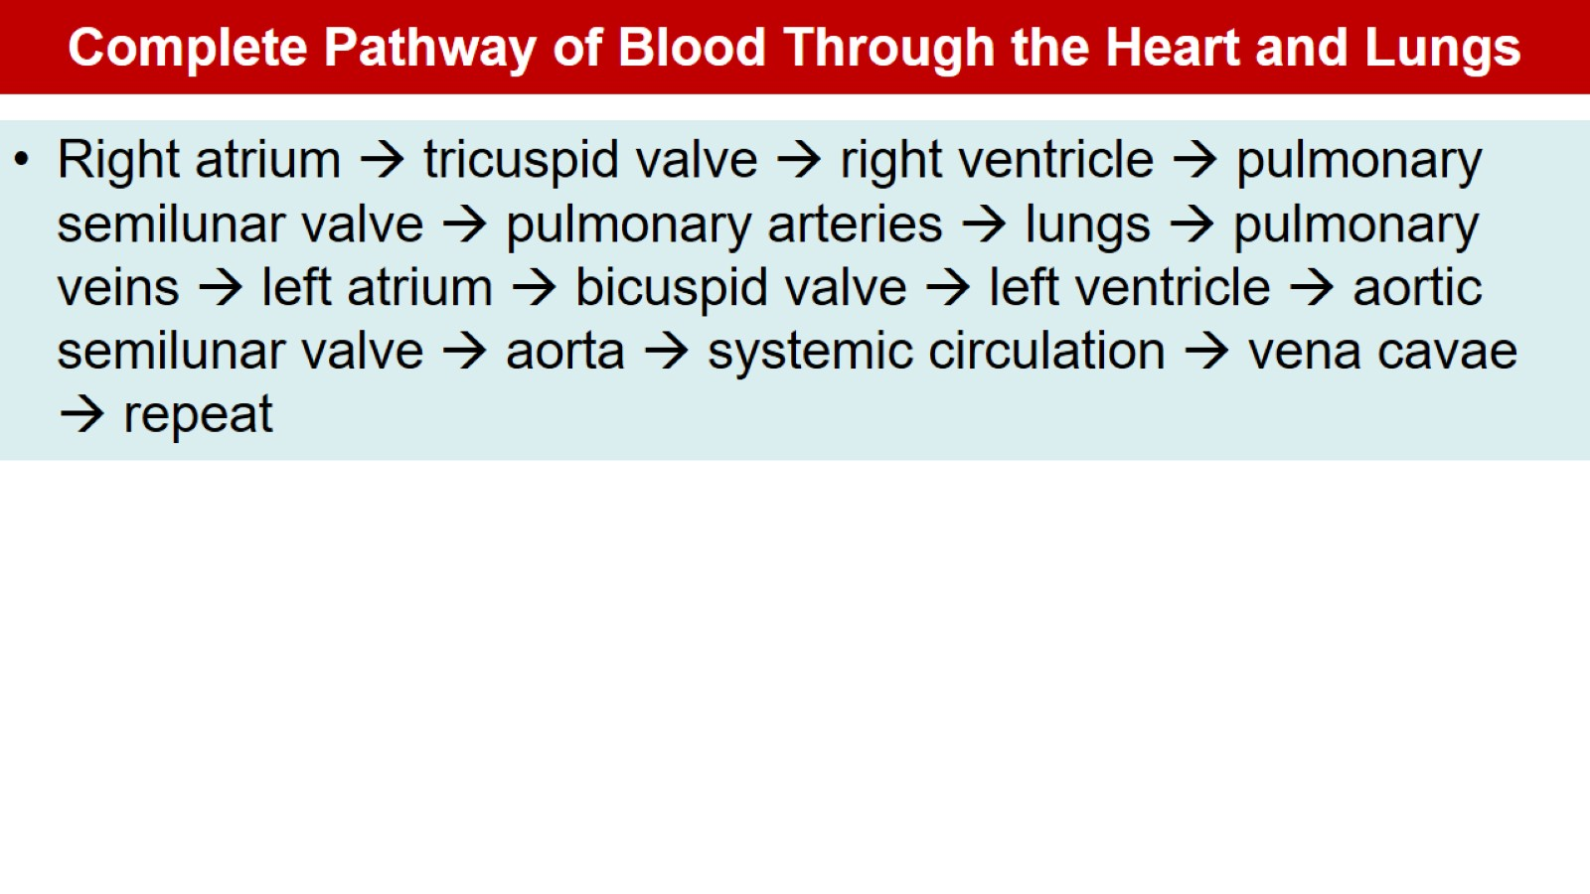
Complete Pathway of Blood Through the Heart and Lungs

Slide 24
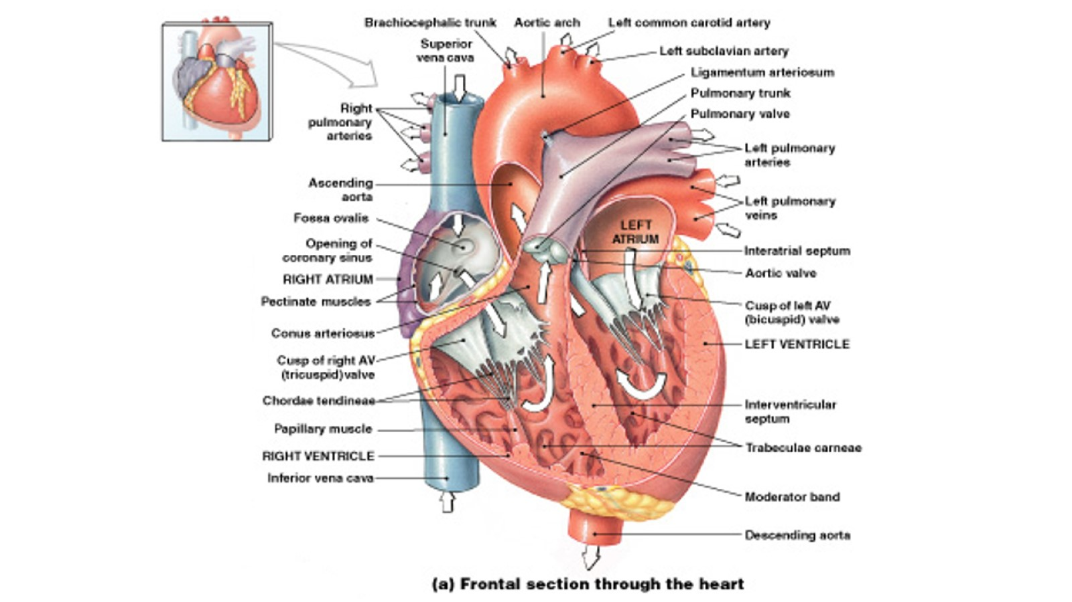

Slide 25
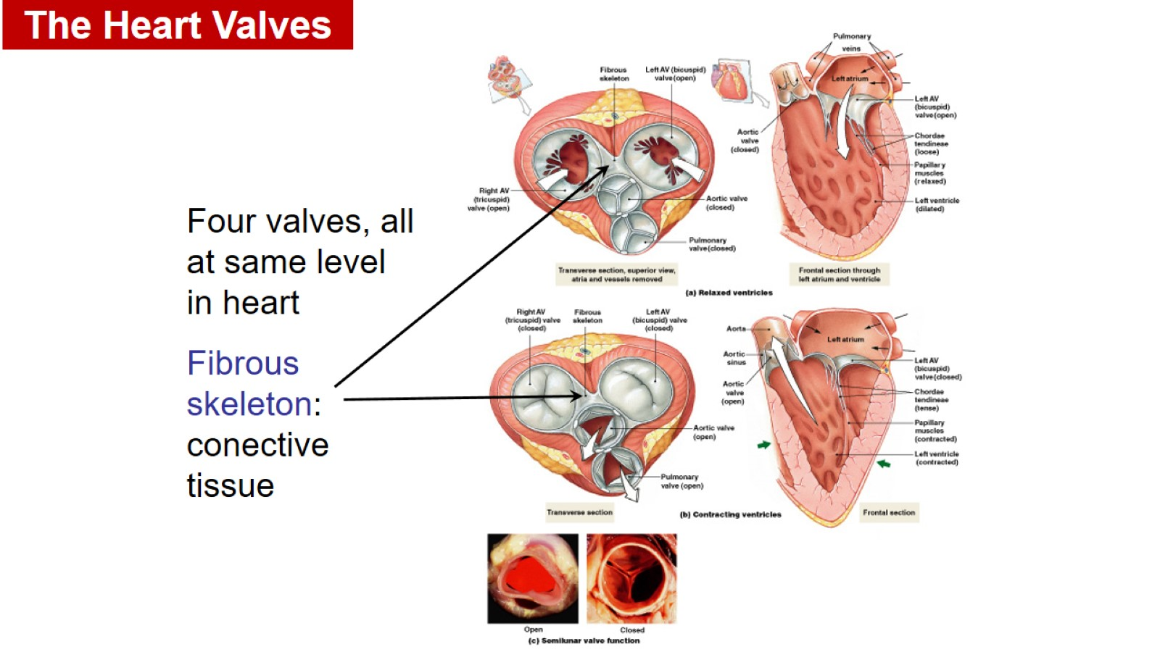
The Heart Valves

Slide 26
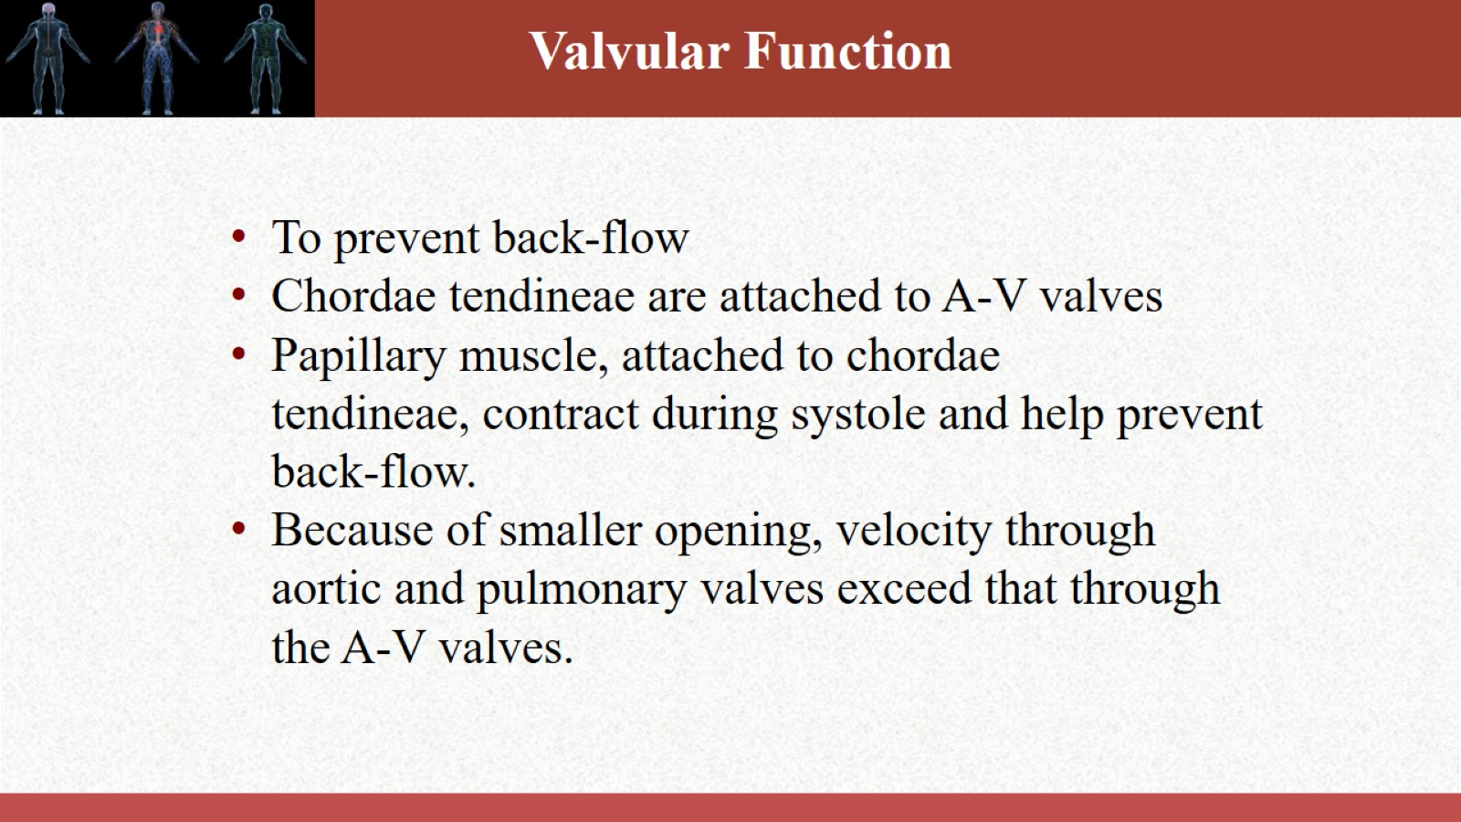
Valvular Function

Slide 27
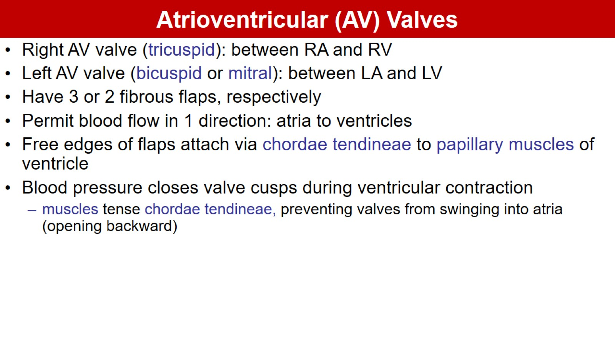
Atrioventricular (AV) Valves

Slide 28
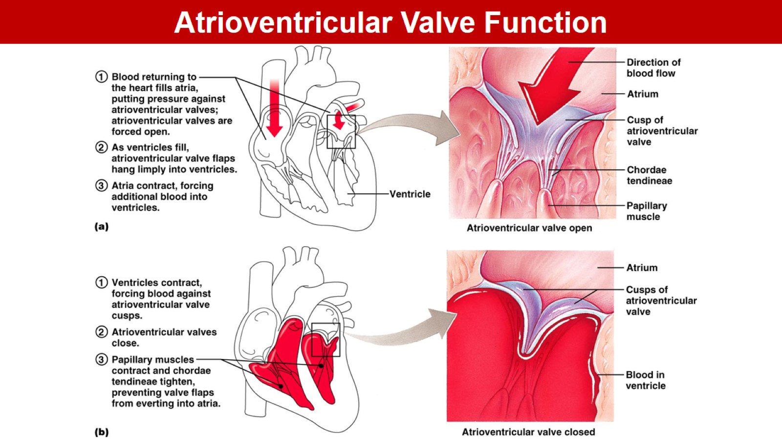
Atrioventricular Valve Function

Slide 29
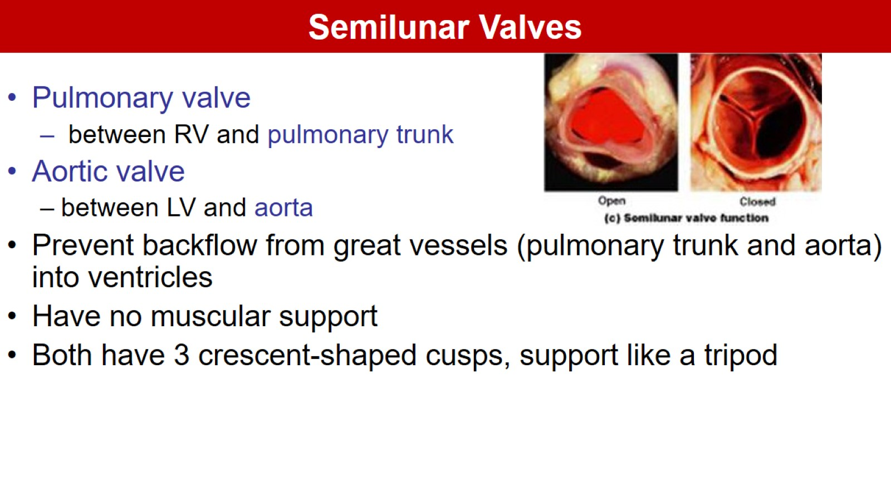
Semilunar Valves

Slide 30
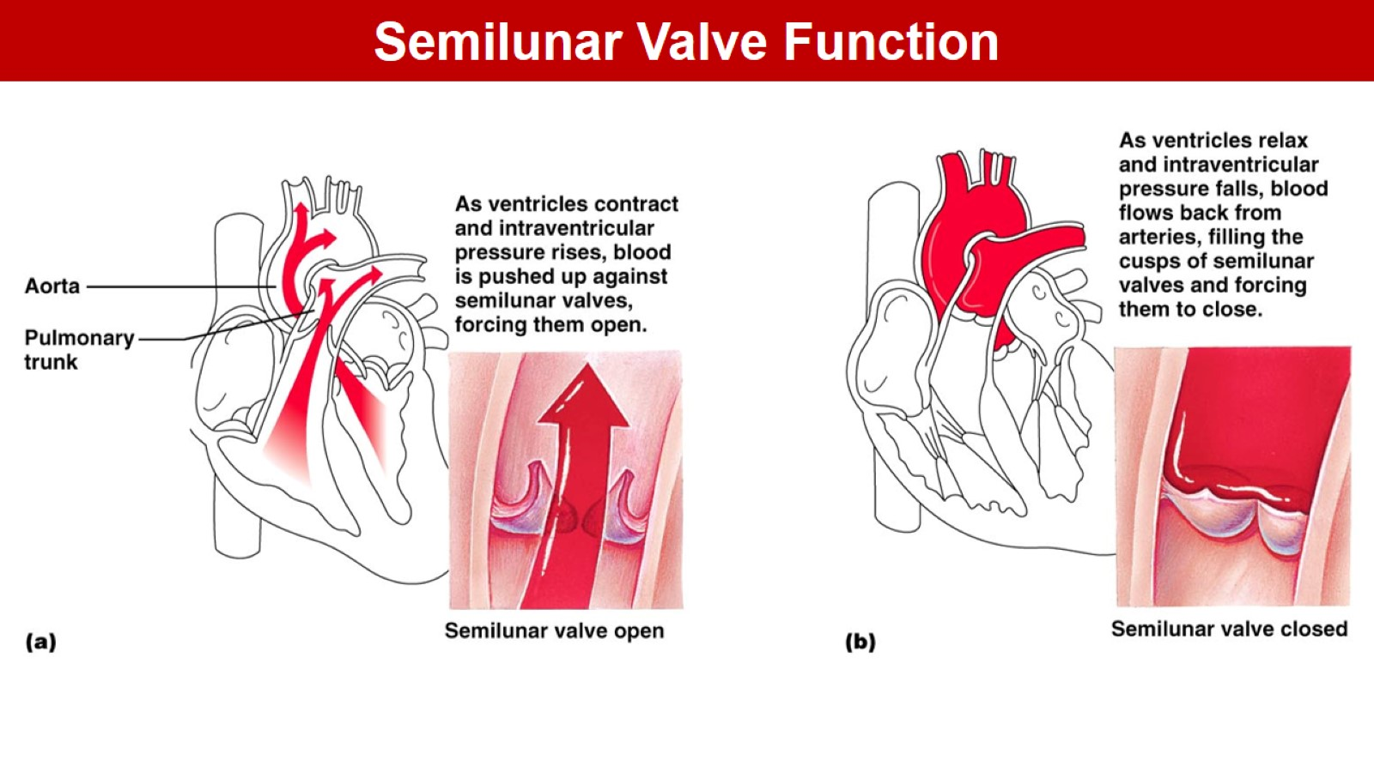
Semilunar Valve Function

Slide 31
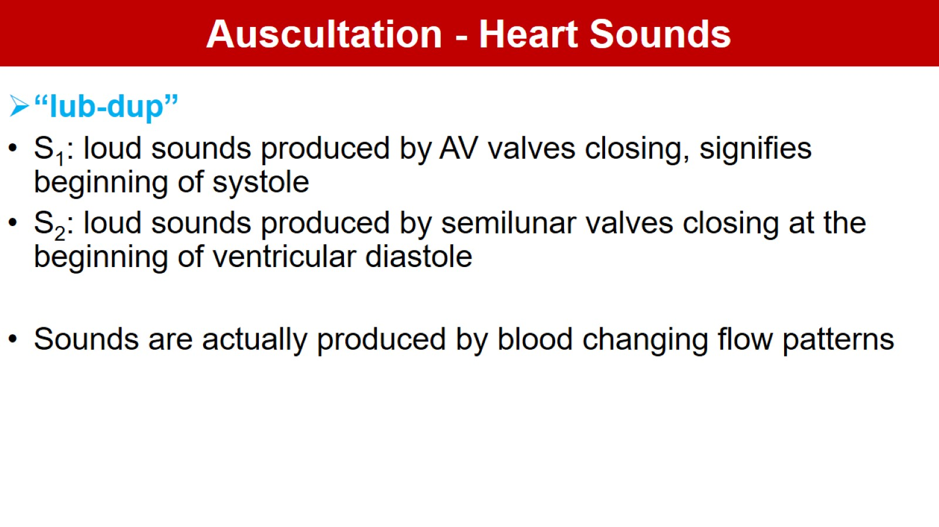
Auscultation - Heart Sounds

Slide 32
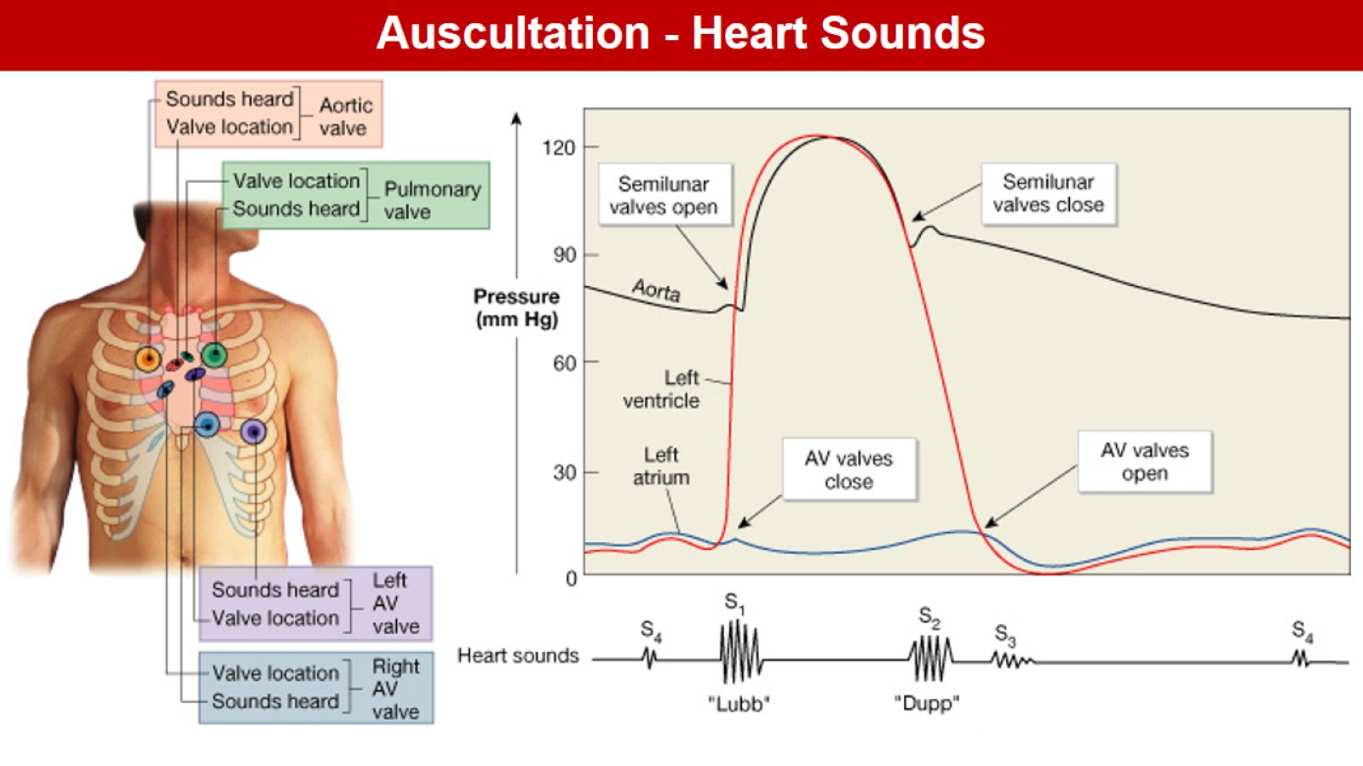

Slide 33
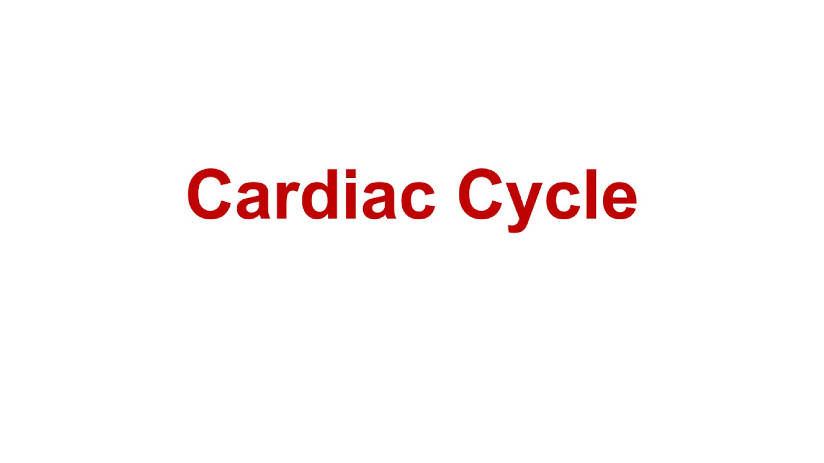
Cardiac Cycle

Slide 34
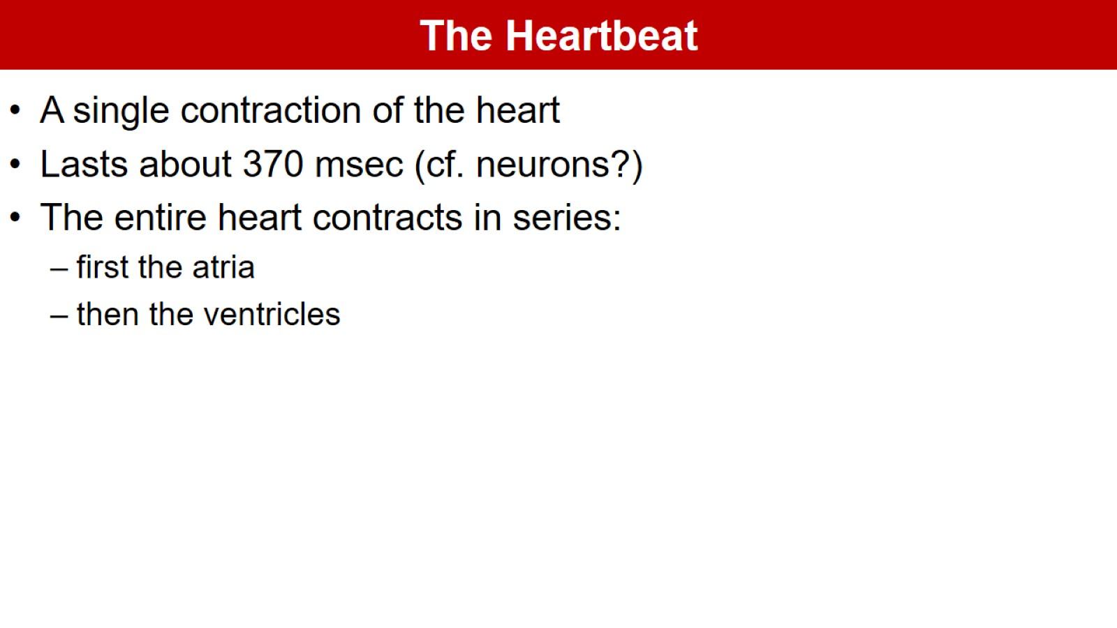
The Heartbeat

Slide 35
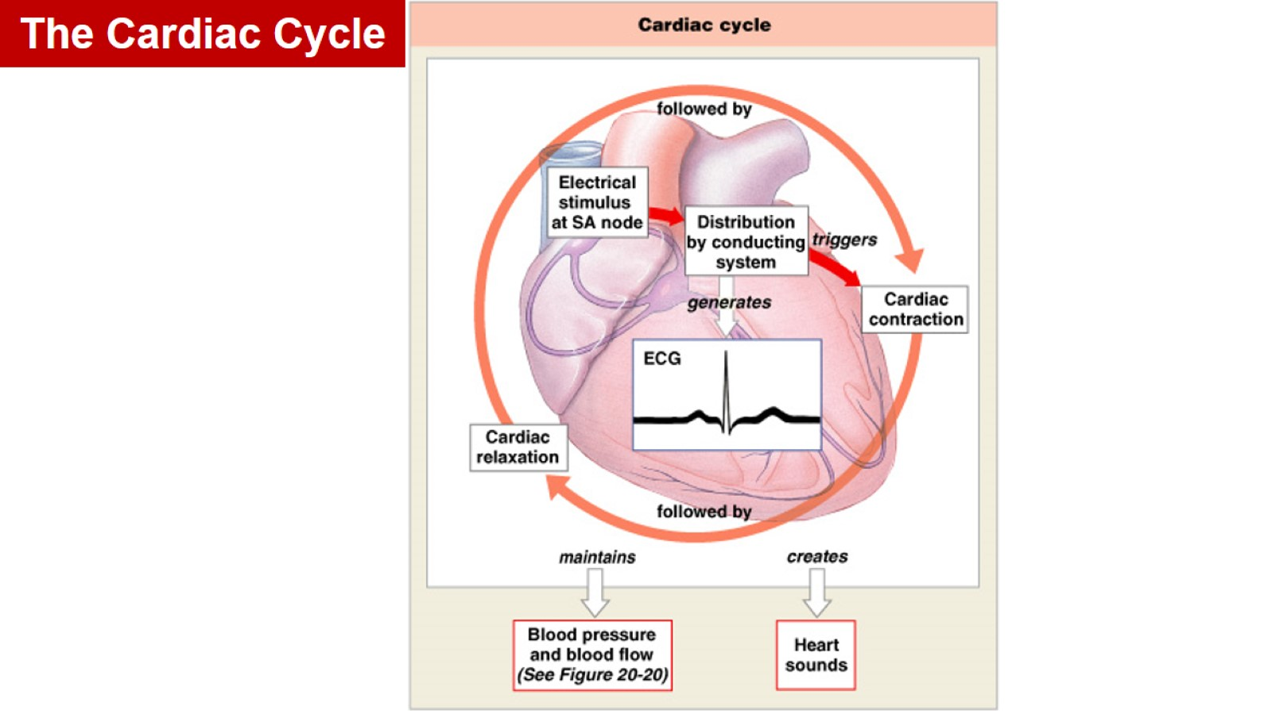
The Cardiac Cycle

Slide 36
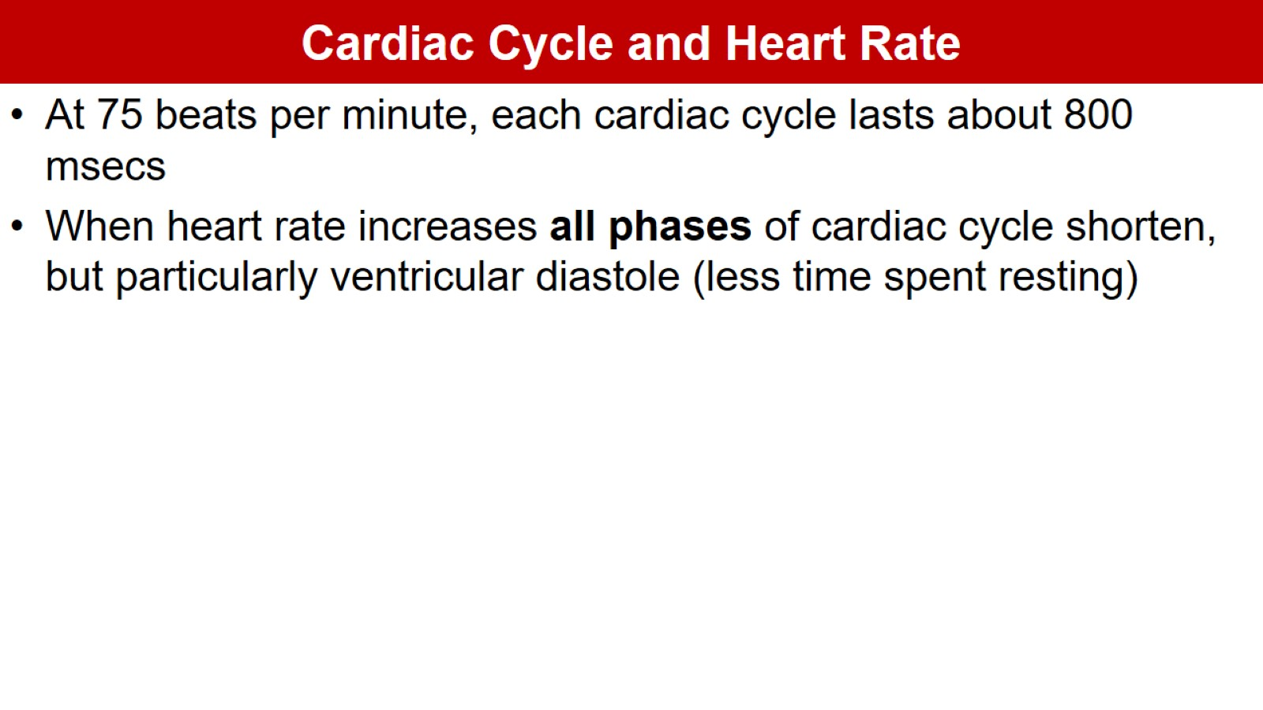
Cardiac Cycle and Heart Rate

Slide 37
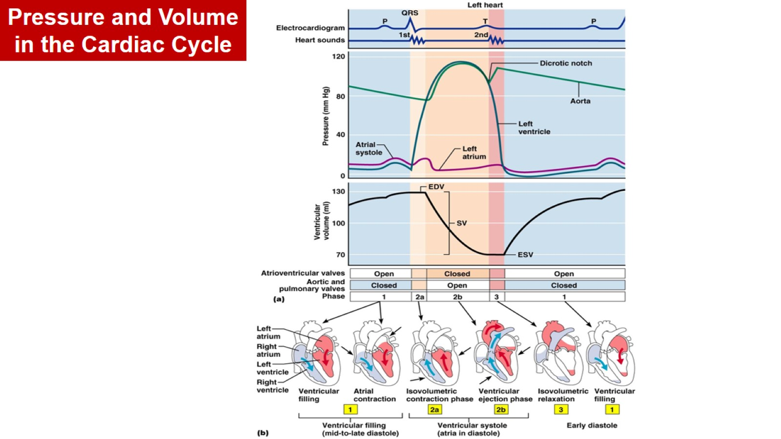

Slide 38
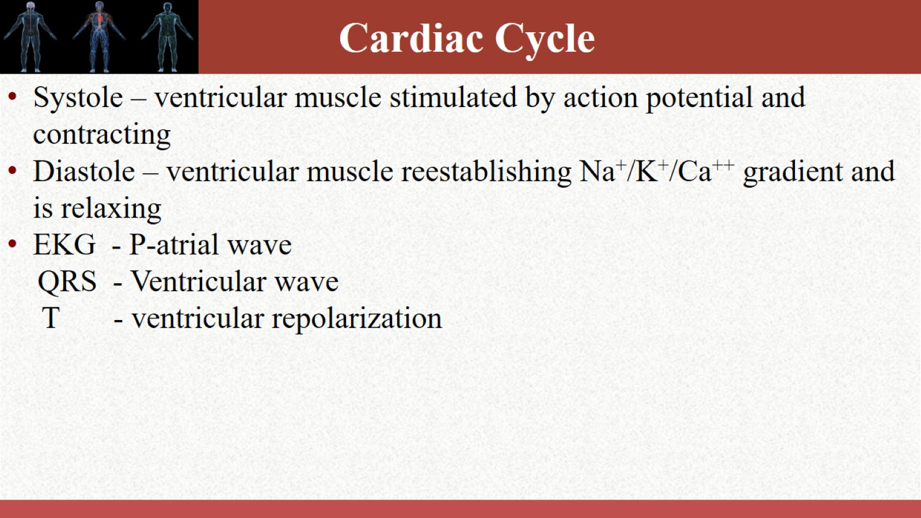
Cardiac Cycle

Slide 39
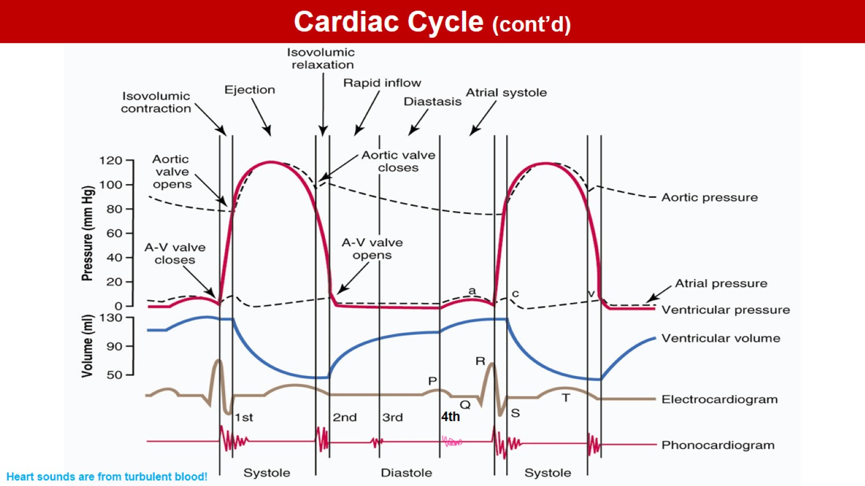

Slide 40
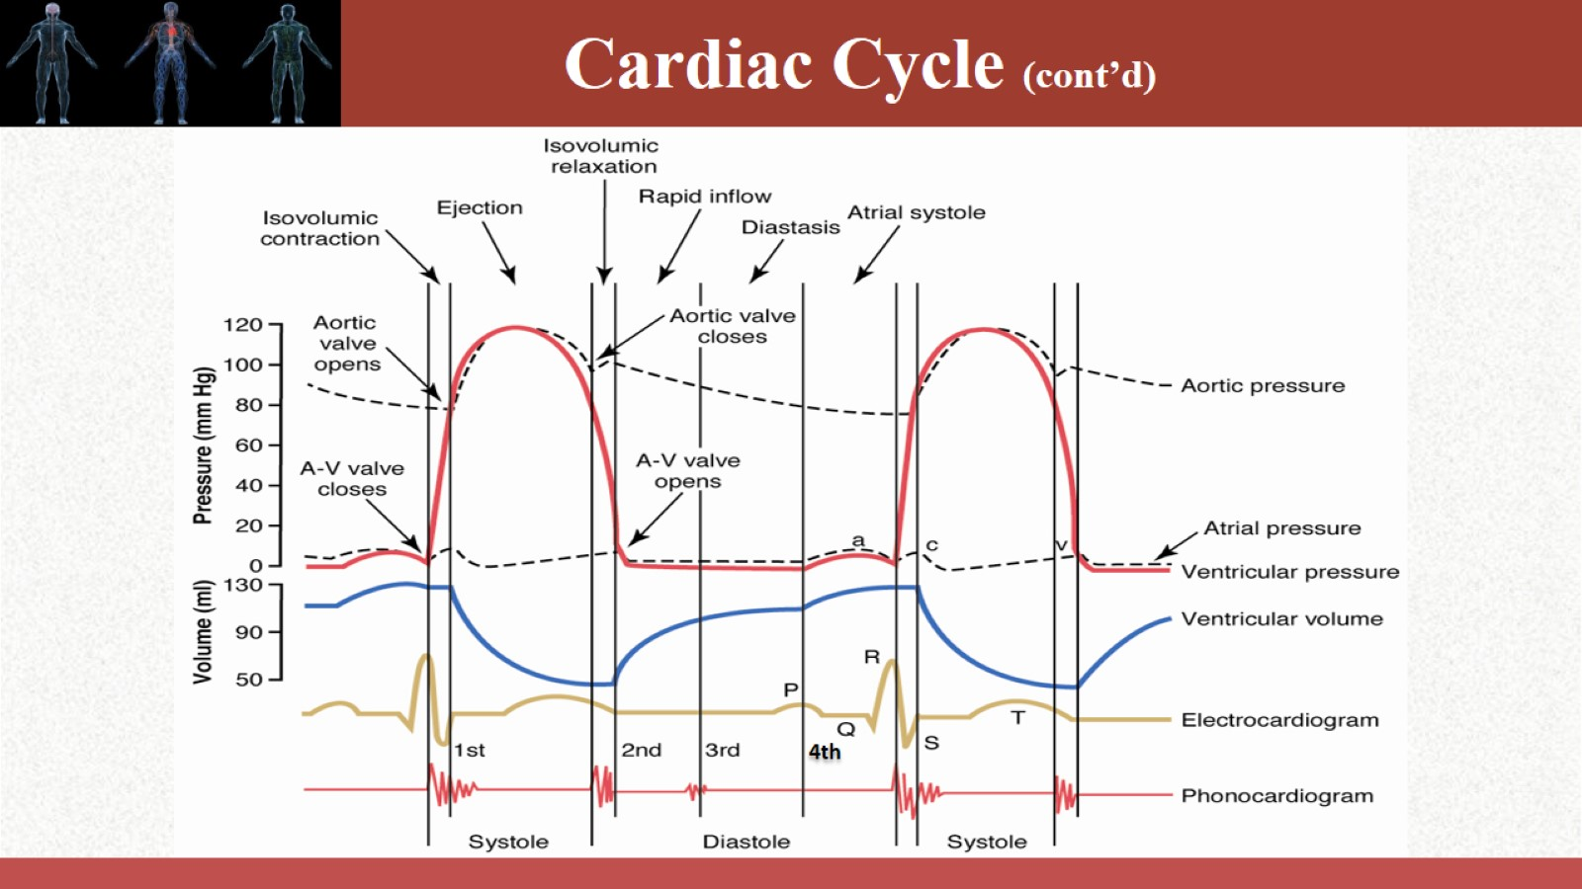
Cardiac Cycle (cont’d)

Slide 41
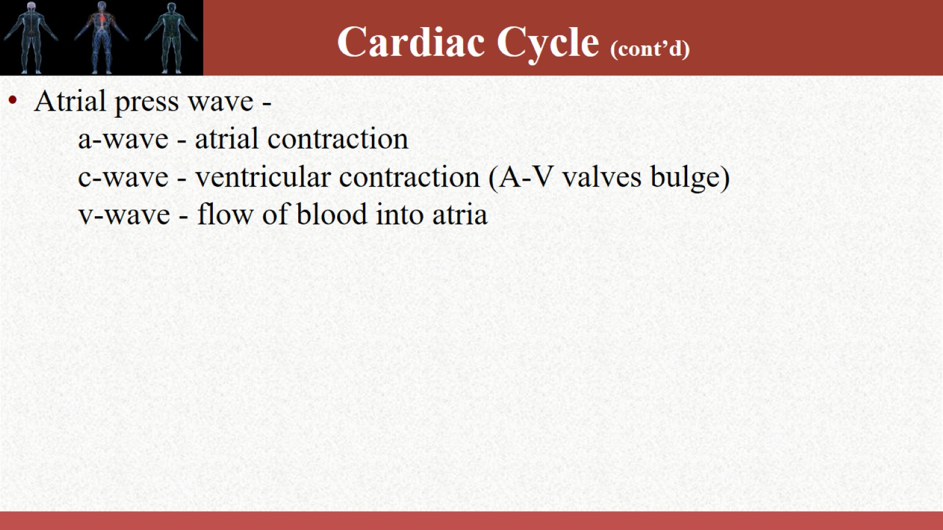
Cardiac Cycle (cont’d)

Slide 42
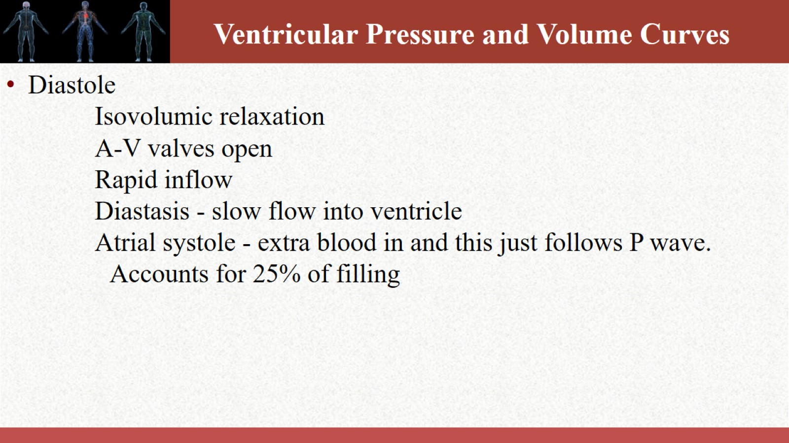
Ventricular Pressure and Volume Curves

Slide 43
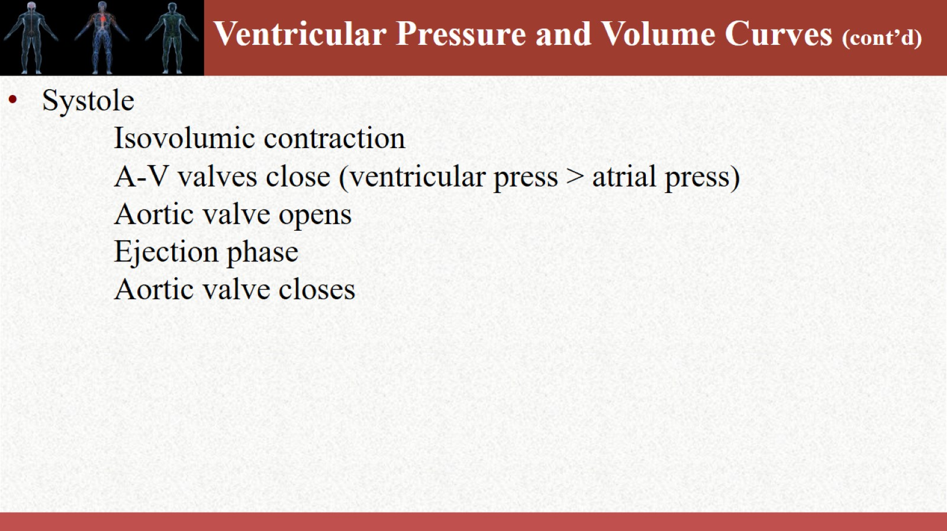
Ventricular Pressure and Volume Curves (cont’d)

Slide 44
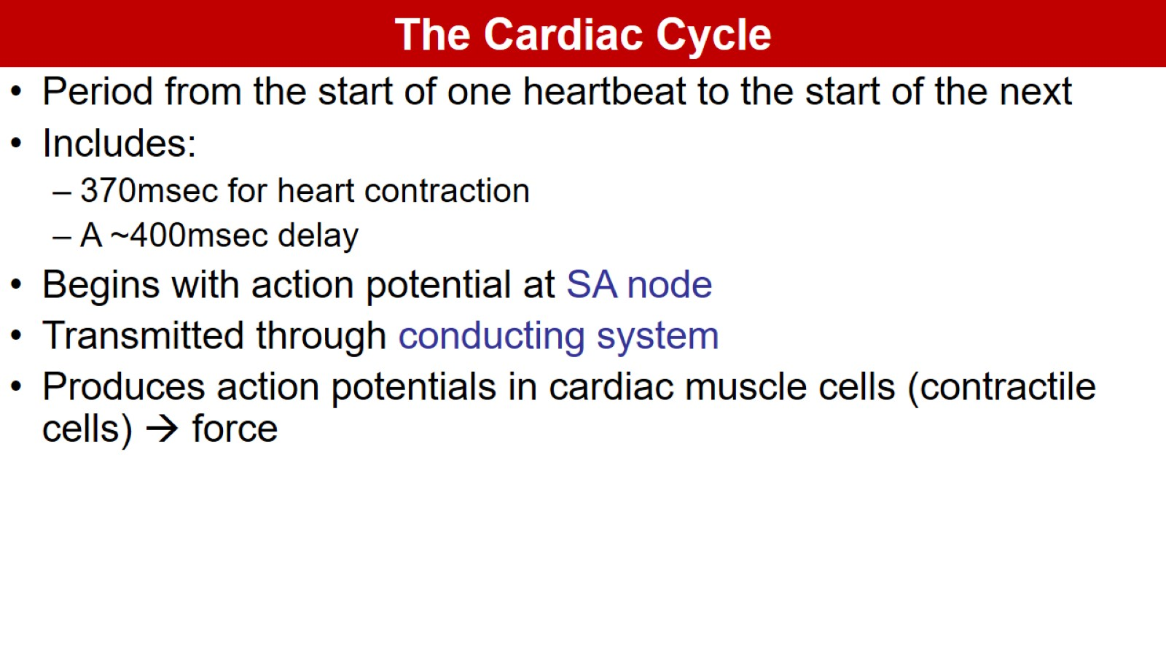
The Cardiac Cycle

Slide 45
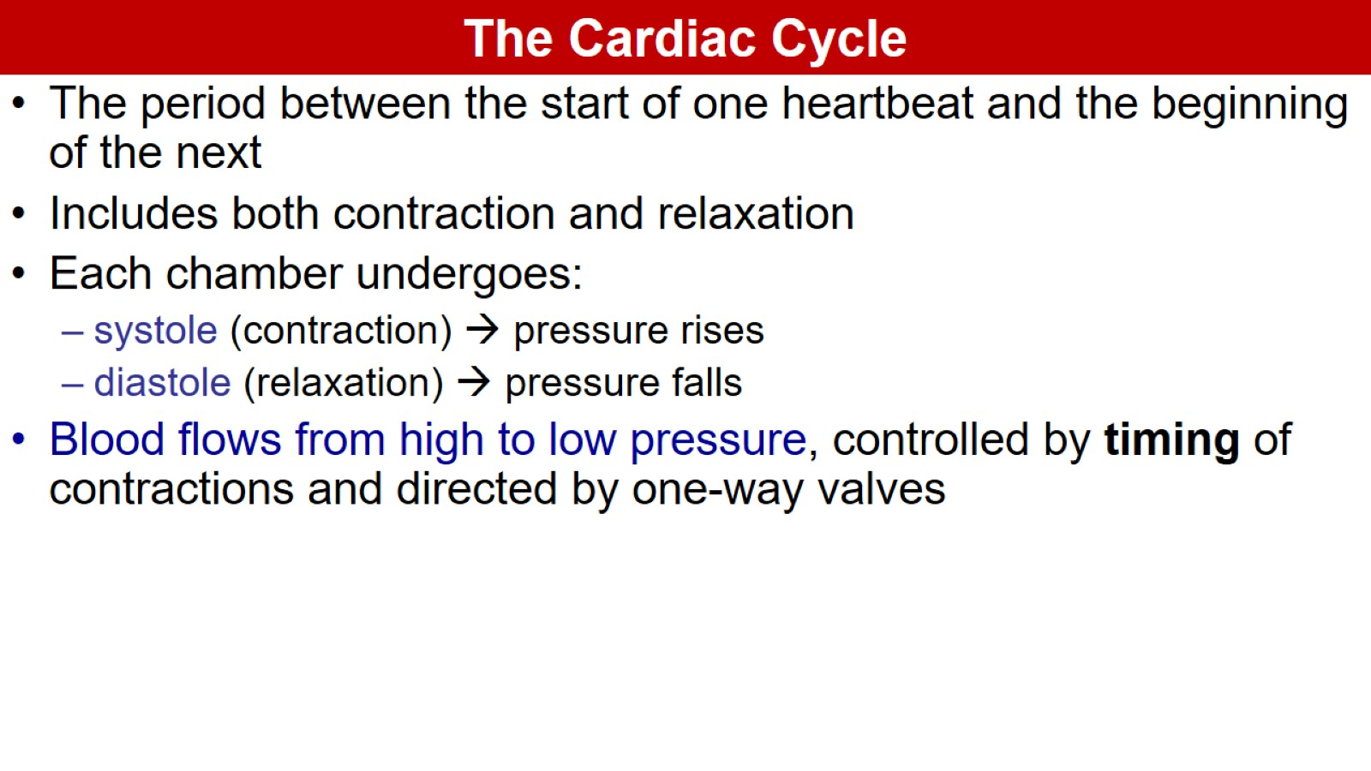
The Cardiac Cycle

Slide 46
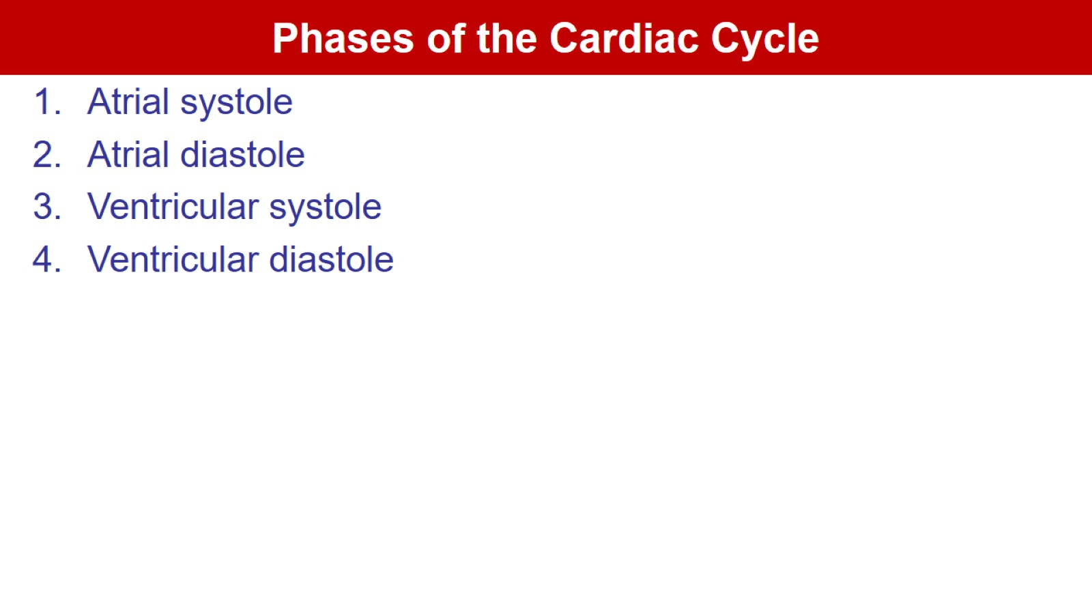
Phases of the Cardiac Cycle

Slide 47
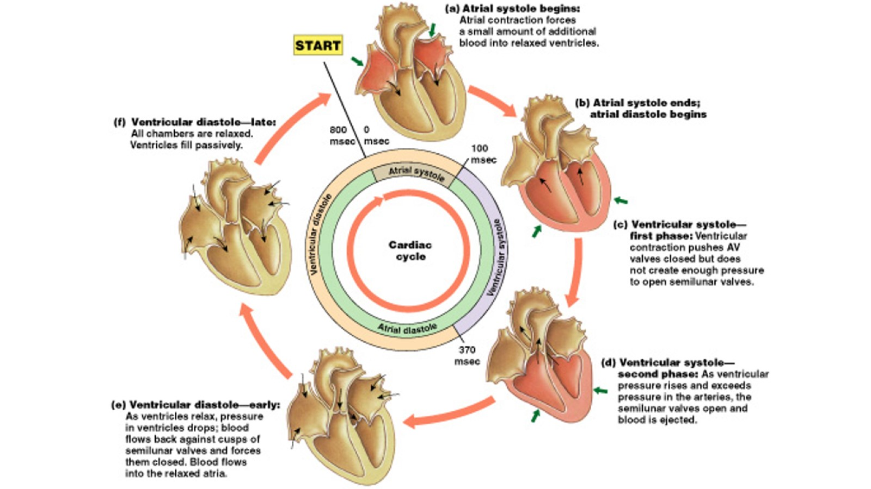

Slide 48
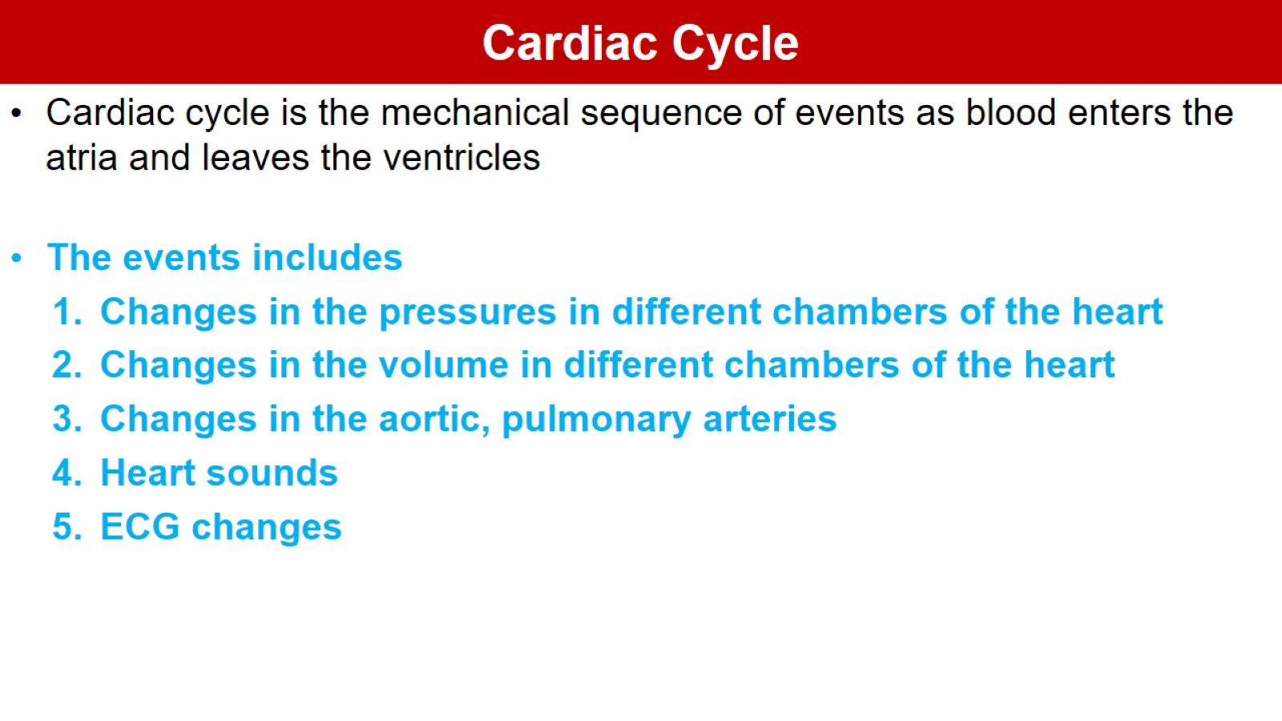
Cardiac Cycle

Slide 49
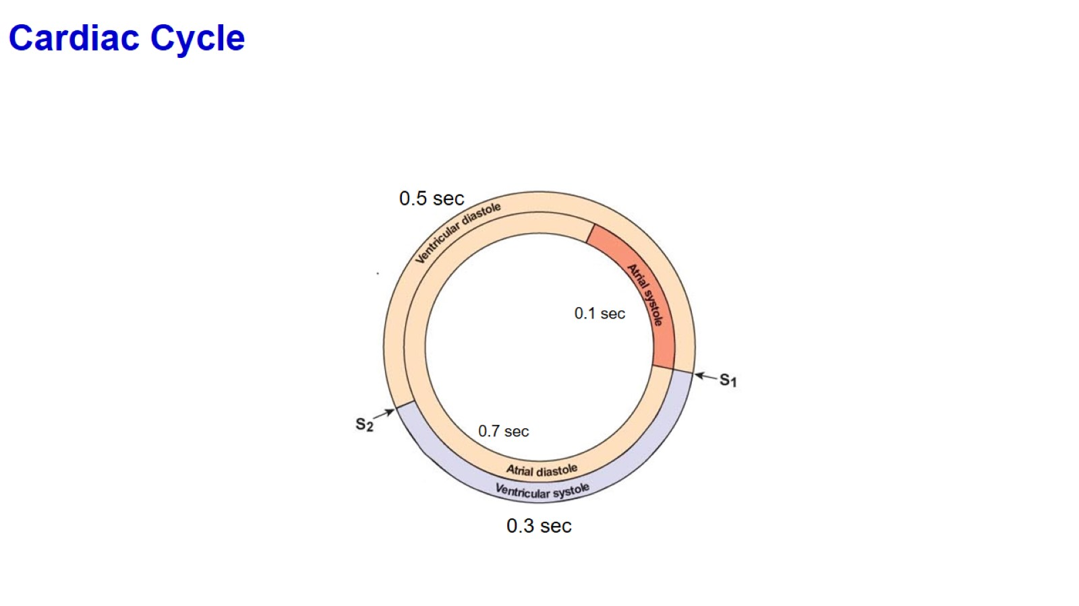
Cardiac Cycle

Slide 50
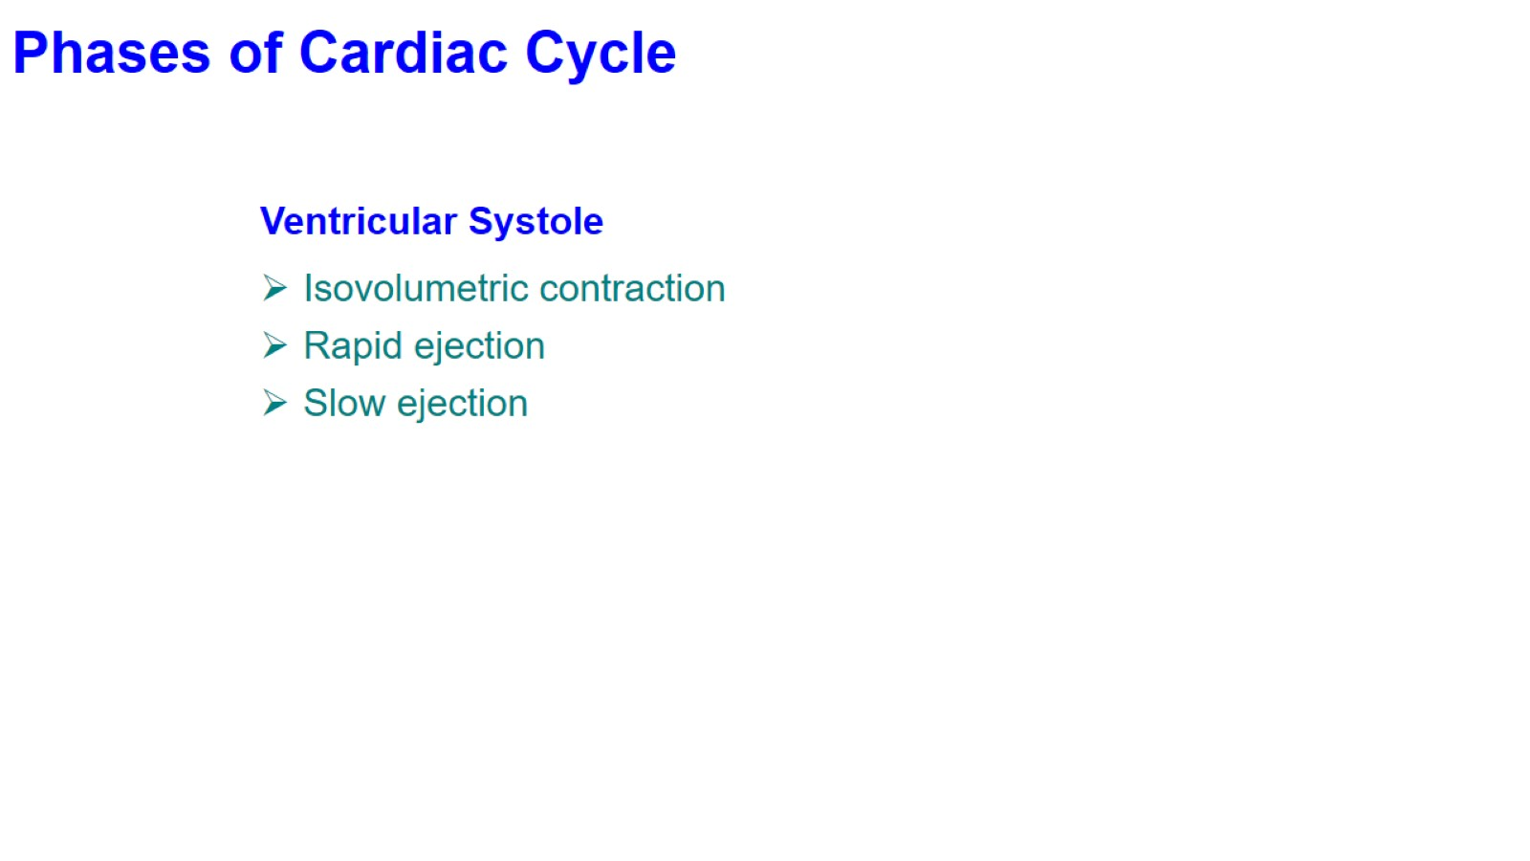
Phases of Cardiac Cycle

Slide 51
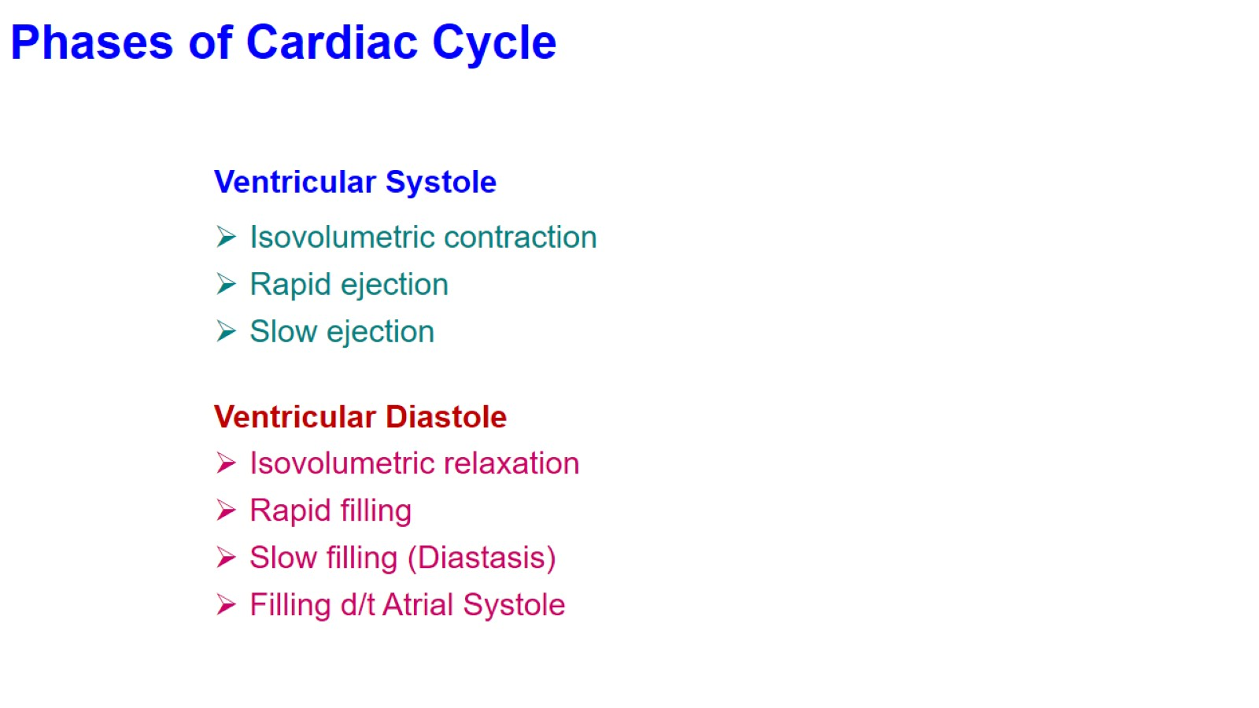
Phases of Cardiac Cycle

Slide 52
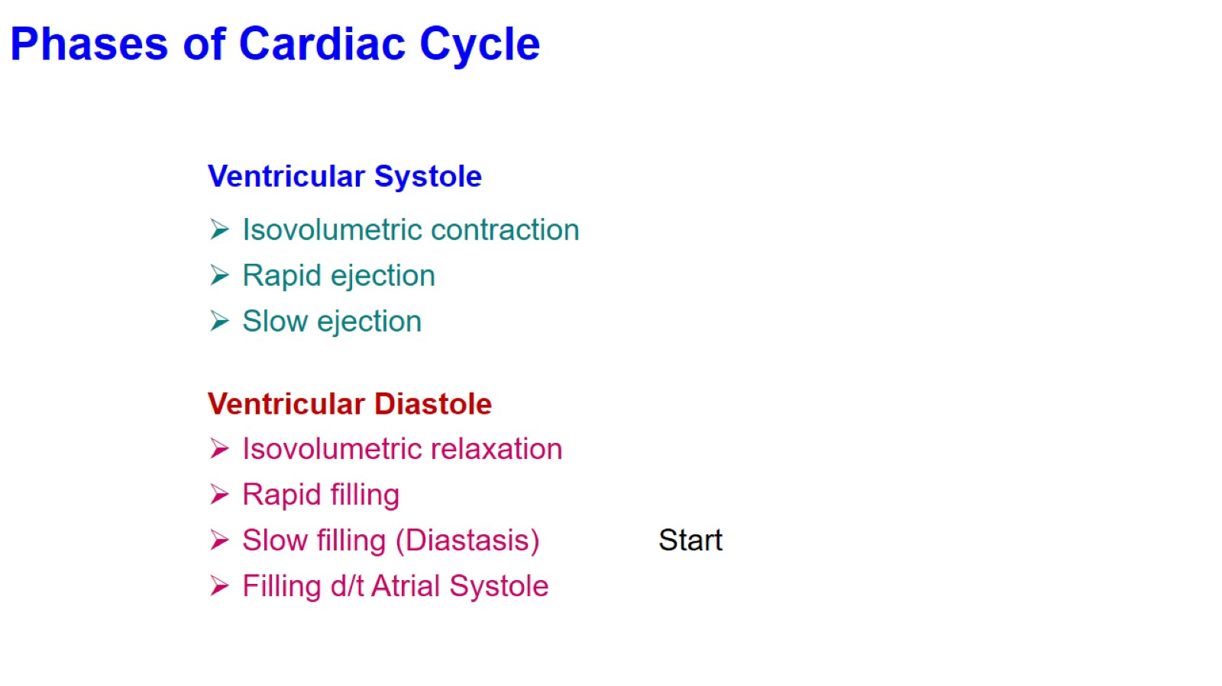
Phases of Cardiac Cycle

Slide 53
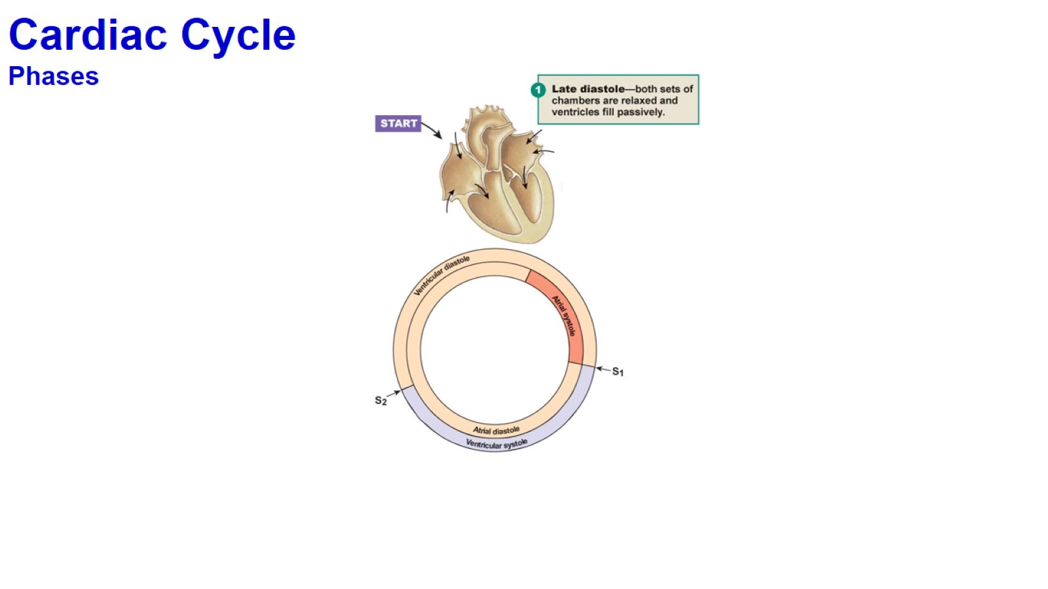
Cardiac Cycle Phases

Slide 54

Cardiac Cycle Phases

Slide 55

Cardiac Cycle Phases

Slide 56

Cardiac Cycle Phases

Slide 57

Cardiac Cycle Phases

Slide 58

Phases of Cardiac Cycle

Slide 59

Ventricular Systole

Slide 60

Ventricular Diastole

Slide 61

Phases of Cardiac Cycle

Slide 62

8 Steps in the Cardiac Cycle

Slide 63

8 Steps in the Cardiac Cycle

Slide 64

8 Steps in the Cardiac Cycle

Slide 65

8 Steps in the Cardiac Cycle

Slide 66

Phases of Cardiac Cycle-step by step-800mSec- only 370mSec for Systoles

Slide 67

Isovolumic Contraction of Ventricles

Slide 68

Ventricular Ejection

Slide 69

Isovolumic Relaxation of Ventricles

Slide 70

Ventricular Filling

Slide 71

Normal Volume of Blood in Ventricles

Slide 72

A Simple Model of Stroke Volume

Slide 73


Slide 74

Ventricular Pressures

Slide 75


Slide 76

Jugular venous pulse waves

Slide 77

Jugular venous pulse waves

Slide 78

Jugular venous pulse waves

Slide 79

Jugular venous pulse waves

Slide 80

Aortic Pressure Curve

Slide 81

Ventricular Pressure and Volume Curves (cont’d)

Slide 82

Cardiac Output (CO)‏

Slide 83

Ejection Fraction

Slide 84

Ejection Fraction (cont’d)

Slide 85


Slide 86


Slide 87


Slide 88


Slide 89


Slide 90


Slide 91


Slide 92


Slide 93


Slide 94

Valvular Function (cont’d)

Slide 95

Frank-Starling Mechanism

Slide 96


Slide 97

Autonomic Effects on Heart

Slide 98


Slide 99

Cardiac Contractility

Slide 100

Lecture :

Slide 101


Slide 102


Slide 103


Slide 104


Slide 105

Phonocardiograms examples

Slide 106

Heart Sounds & Murmurs

Slide 107


Slide 108

Heart Sounds

Slide 109

Heart sounds

Slide 110

First heart sound

Slide 111

Second heart sound

Slide 112

Heart Murmur

Slide 113

Two Basic Types of Valvular Diseases

Slide 114


Slide 115


Slide 116

Dynamics Of Streptococcal Damage To Heart Valves

Slide 117


Slide 118

Dynamics Of Streptococcal Damage To Heart Valves

Slide 119

Dynamics Of Streptococcal Damage To Heart Valves

Slide 120

Mitral Stenosis Murmur

Slide 121

Mitral Stenosis Hemodynamics

Slide 122


Slide 123


Slide 124

Mitral Regurgitation Murmur

Slide 125

Mitral Regurgitation Hemodynamics

Slide 126


Slide 127


Slide 128

Aortic Stenosis Murmur

Slide 129

Aortic Stenosis Hemodynamics

Slide 130


Slide 131


Slide 132

Aortic Regurgitation Murmur

Slide 133

Aortic Regurgitation Hemodynamics

Slide 134


Slide 135


Slide 136

Patent Ductus Arteriosus

Slide 137


Slide 138

Patent Ductus Arteriosus Murmur

Slide 139

Interventricular Septal Defect

Slide 140


Slide 141

Interatrial Septal Defect

Slide 142


Slide 143


Slide 144


Slide 145


Slide 146


Slide 147


Slide 148


Slide 149


